Slide 1
CAUSES AND CONSEQUENCES OF RISING INCOME INEQUALITY IN ADVANCED ECONOMIES
Danijela Lazović Vuković
Supervisor: Professor Jože P. Damijan
  School of Economics and Business
  University of Ljubljana
  Ljubljana, 19th May, 2026

Slide 2
PRESENTATION OUTLINE
MOTIVATION
FURTHER RESEARCH AND LIMITATIONS
RESULTS AND CONTRIBUTION
POLICY IMPLICATIONS
RESEARCH GAP AND AIMS

Slide 3
PRESENTATION OUTLINE
MOTIVATION
FURTHER RESEARCH AND LIMITATIONS
RESULTS AND CONTRIBUTION
POLICY IMPLICATIONS
RESEARCH GAP AND AIMS

Slide 4
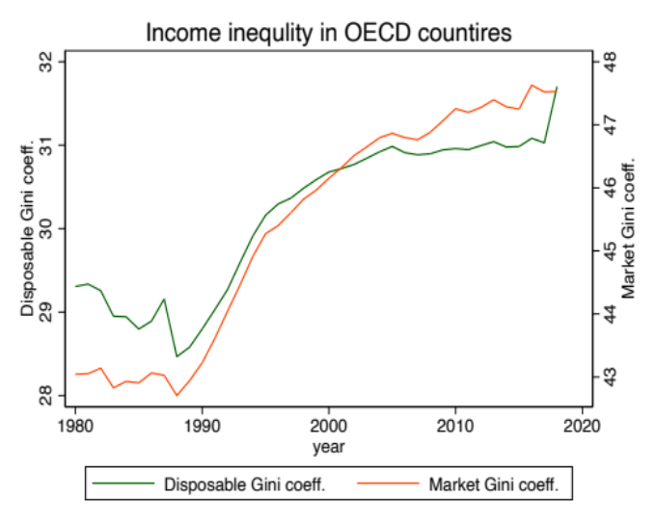
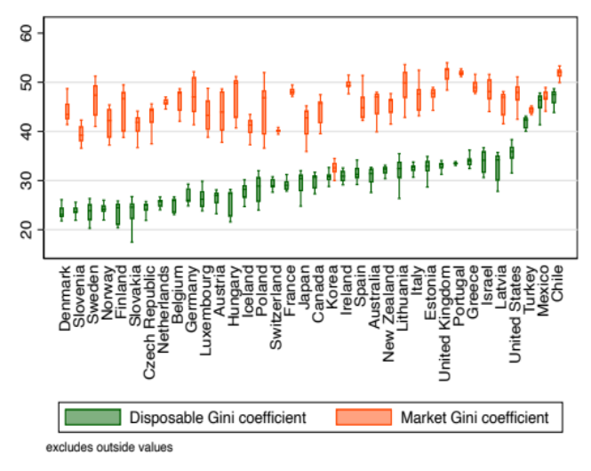
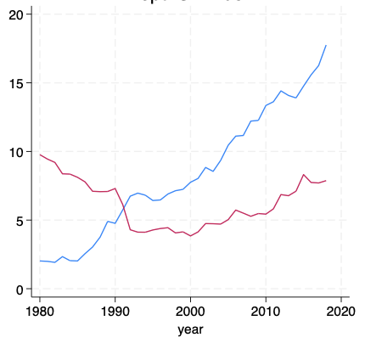

Motivation
Significant and persistent rise in income inequality in advanced economies over the past four decades:
    Recognized as one of the major global challenges ahead.
    Associated with rising social and political tensions.
    Not adequately explained by traditional theories (Kuznets, 1955; Tinbergen, 1975).
    Although technology and globalization emerge as key drivers, they do not fully capture the complexity of the observed dynamics.
Paradoxical absence of policy response and rising right-wing populism when intuitively rising inequality should elicit support for the left.
Figure 1: Income inequality in OECD countries from 1980-2018
Figure 2: Income inequality measured by disposable Gini coefficient (in OECD countries from 1980-2018)
Figure 3: Average vote share of populist parties in EU countries (1980-2018)

Slide 5
PRESENTATION OUTLINE
MOTIVATION
FURTHER RESEARCH AND LIMITATIONS
RESULTS AND CONTRIBUTION
POLICY IMPLICATIONS
RESEARCH GAP AND AIMS

Slide 6
Research gap and aims
    Aim: Provide a comprehensive quantitative analysis of the causes and consequences of rising income inequality in advanced economies.
    The thesis approaches this task through three chapters, six main research questions and by testing several theoretical hypotheses.
Chapter/Study | Research question | Key hypotheses tested
2nd Chapter (Study I) “Drivers of Income Inequality in OECD Countries: Testing the Milanovic's TOP Hypothesis” | 1. What are the causes of income inequality within developed countries? 2. To what extent could globalization and technology be blamed for the observed rise in income inequality within advanced economies? 3. What is the role of redistributive policies in mitigating the effect of globalization on income inequality? | TOP Hypothesis Cushioning effect
3rd Chapter (Study II) “Inequality and Redistribution: Testing Median Voter Hypothesis and Its Extensions” | 4. Does a higher level of within-country income inequality lead to higher support for redistributive policies? 5. Does the exposure of a country to immigration and international trade impact the relationship between income inequality and the support for redistributive policies? | Median Voter Hypothesis Social Affinity Hypothesis Compensation Hypothesis Power Resource Theory Welfare Chauvinism Hypothesis
4th Chapter (Study III) “Unequal roots of populism: Testing Rodrik’s hypothesis” | 6. To what extent is the recent rise in populism driven by the increase in income inequality? | Rodrik’s hypothesis
Technological progress
Political Populism
Income inequality
Policy
(II)
Globalization
(I)
(I)
(I)
(III)
(II)
(III)
CAUSES
CONSEQUENCES
(II)
Notes:
Paper 1 aim
Paper 2 aim
Paper 3 aim -
Guided by Rodrik’s (2018) cleavage framework, we test the hypothesis that economic hardship drives support for left-wing populism (income-based cleavage), whereas exposure to globalization, through trade and immigration, drives right-wing populism (identity-based cleavage).
We study to what extent growing income inequality, openness to trade, financial globalization, and immigration could explain electoral behavior in the new political era.
The aim of this paper is to fill a gap in the existing literature by providing a macro-level, multidisciplinary analysis of structural drivers of left and right-wing populism in Europe, offering a novel alternative to dominant individual-level approaches.
Most existing studies either focus on single-country cases or rely on individual-level data, limiting their comparability with our macro-level, cross-country analysis (see reference list). The literature that decides to take macro-level methodological path is limited, and our findings drastically differ (Bergh & Kärnä, 2021).

Slide 7
Research gap and aims
    Identified gap in the literature
      Chapter 2: TOP and inequality
        Existing studies focus on globalization and technology
        Role of policy and institutional settings in shaping inequality outcomes overlooked as stressed by Piketty (2014) and Milanovic (2016).
      Chapter 3: Inequality and redistribution
        Few studies since the MVH framework (Meltzer & Richard, 1981)
        Limited by lack of reliable and comparable data
        Redistribution long neglected by academics and policymakers (Lucas, 2003; Okun, 1975)
      Chapter 4: Political populism and inequality
        Existing studies focus on individual-level data and voter attitudes
        Often limited to single-country analyses, hindering generalization
        Commonly examine only one side of the political spectrum
Figure 4: Conceptual Map of Thesis Structure
Income inequality
Technological progress
Political Populism
Globalization
Policy
CAUSES
CONSEQUENCES
Chapter 2:
TOP Hypothesis
Cushioning effect
Chapter 3:
Median Voter Hypothesis
Social Affinity Hypothesis
Compensation Hypothesis Power Resource Theory
Welfare Chauvinism Hypothesis
Chapter 4:
Rodrik’s hypothesis

Slide 8
PRESENTATION OUTLINE
MOTIVATION
FURTHER RESEARCH AND LIMITATIONS
POLICY IMPLICATIONS
RESEARCH GAP AND AIMS
RESULTS AND CONTRIBUTION

Slide 9
Chapter 2 – Data and methodology
Drivers of Income Inequality in OECD Countries: Testing the Milanovic's TOP Hypothesis
Openness ratio
Share of inward FDI (% of GDP)
KOF Trade Globalization Index, de jure
KOF Financial Globalization Index, de jure
  RQ 1-3
  Sample: 36 OECD countries, 1980–2018
  Main data sources:
    SWIID - Gini coefficients;
    OECD database - Gross domestic spending on R&D (as % of GDP), employment share in services (as % of total employment), long-run unemployment rate and EPL of temporary contracts;
    QOG OECD dataset - Public expenditure on education (as % of GDP);
    KOF globalization indices;
    Correlates of War Project Trade Data Set - imports from China;
    Government revenue dataset - direct income taxes;
    World Bank's WDI database - GDP data
Quantitative methods:
    Fixed Effects (two-way)
    GMM
    Five-year differences
    Fixed Effects with multiple imputation adjustments
Market Gini coeff.
Disposable Gini coeff.
KOF trade globalization
KOF financial globalization
Share of imports from China (% of imports)
$\ln\left({INQ}_{it}\right)=α+β_{1}\ln\left(T_{i,t−1}\right)+β_{2}\ln\left(O_{i,t−1}\right)+β_{3}\ln\left(P_{i,t−1}\right)+β_{4}ln(Z_{i,t−1})+C+T+ε_{it}$
Additional model specifications:
      China shock & EPL cushioning effect
ICT capital stock (% of GFCF)
Tangible ICT capital services contribution
Value-added TFP
OECD multifactor productivity
Direct income tax rate
Public expenditure on education (% GDP)
EPL
$$\ln\left({INQ}_{it}\right)=α+β_{1}ln(T_{i,t−1})+β_{2}ln(O_{i,t−1})+β_{3}{ln(P}_{i,t−1})+β_{4}ln(Z_{i,t−1})+$$
$$+β_{5}{ln(CH}_{i,t−1})∗ch_{shock}+β_{6}ln({CH}_{i,t−1})∗ch_shock∗{ln(EPL}_{i,t−1})+C+T+ε_{it}$$
R&D spending (% of GDP)
      Systemic differences between countries
$$\ln\left({INQ}_{it}\right)=α+\left(β_{1}T_{i,t−1}+β_{2}O_{i,t−1}+β_{3}P_{i,t−1}+β_{4}Z_{i,t−1}\right)∗nordsoc+C+T+ε_{it}$$
      The unequal distribution of growth hypothesis
$$\ln\left({INQ}_{it}\right)=α+β_{1}ln(T_{i,t−1})+β_{2}{ln(O}_{i,t−1})+β_{3}ln(P_{i,t−1})+β_{4}ln(Z_{i,t−1})+$$
$$+β_{5}ln({GDP}_{i,t−1})∗{ln(INC}_{i,t−1})+C+T+ε_{it}$$
      The Tinbergen’s hypothesis
$$\ln\left({INQ}_{it}\right)=α+β_{1}ln(T_{i,t−1})+β_{2}{ln(O}_{i,t−1})+β_{3}ln(P_{i,t−1})+β_{4}ln(Z_{i,t−1})+$$
$$+β_{5}ln({RD}_{i,t−1})∗{ln(EDUC}_{i,t−1})+C+T+ε_{it}$$

Slide 10
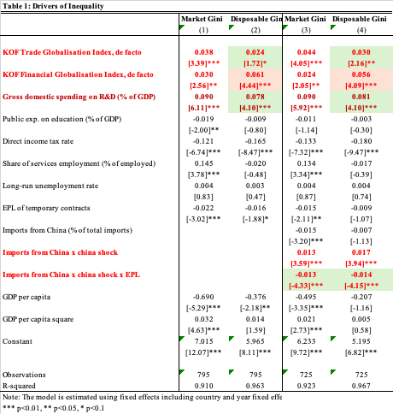
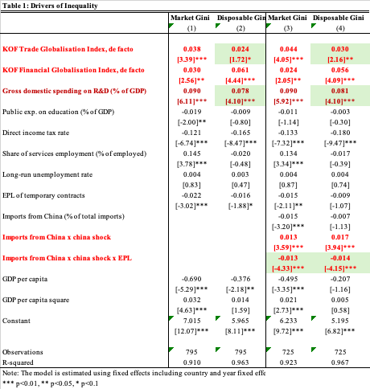
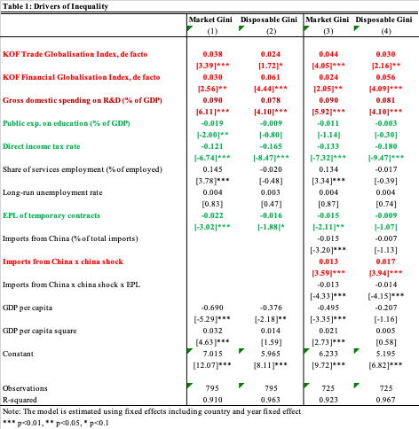
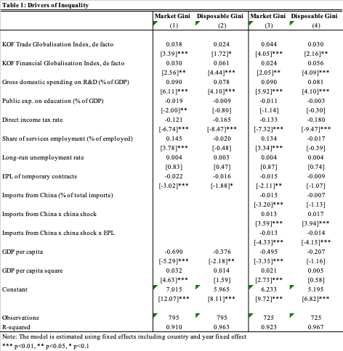
Chapter 2 - Results and contribution
Advances the empirical frontier - comprehensive test of Milanovic’s TOP hypothesis
    Assesses joint and relative effects of technological progress, openness (globalization) & policy (institutions) and confirms their combined role in shaping income inequality in advanced economies (in line with Jaumotte & Osorio, 2015).
    Previous studies rarely examined all three TOP drivers simultaneously.
Reveals dual equalizing role of policy - key contribution
    EPL and direct income taxes directly reduce inequality.
    Redistributive policies have indirect (cushioning) effect on trade & technology shocks.
    EPL cushions the effect of the China shock
    Financial globalization remains resilient to policy intervention.

Slide 11
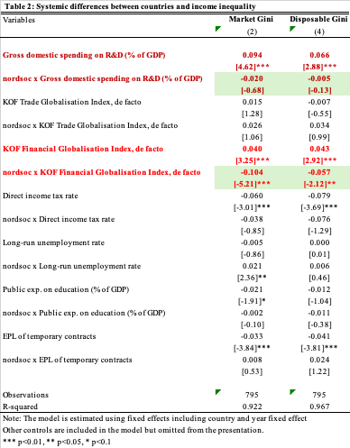
Chapter 2 - Results and contribution
    Provides first empirical evidence on welfare regime differences mitigating globalization’s effects on inequality.
    In supplementary analysis rejects:
      the unequal distribution of growth hypothesis
      the Kuznets hypothesis (in line with Roser and Cuaresma, 2016)
      the Tinbergen’s hypothesis
    Provides an abundance of robustness tests (different definitions of trade and technological progress, data sources, and econometric methodologies)

Slide 12

Chapter 3 – Data and methodology
Inequality and Redistribution: Testing Median Voter Hypothesis and Its Extensions
  RQ 4-5
  Sample: 36 OECD countries, 1980–2018
  Main data sources:
    SWIID and WID - macro level inequality and redistribution data
    LIS micro level data to construct macro level indicators on redistribution and inequality
    OECD database - share of population older than 65 (as % of total population), share of foreign-born population (as % of total population), union density rate, share of inward FDI (as % of GDP), and openness to trade indicator (exports and imports of goods and services, as % of GDP);
    World Bank's WDI database - GDP data;
    Comparative Political Data Set – left-wing populist vote share;
    Varieties of Democracy (V-Dem) - democratization index.
  Quantitative methods:
    Fixed Effects:
      two-way, log transformed variables and regressors smoothed using moving averages (3Y, 4Y & 5Y MA)
      One-way, no data transformation following Milanovic
    GMM (see additional slides for results)
skew
or 50-10 ratio / 90-50 ratio
Market Gini coeff. / Bottom 50 share / Bottom 20 share / Middle class share
Absolute redistribution SWIID
Share gain LIS
$l{n(red}_{it})= α+β_{1}{ineq}_{it}+β_{5}Z_{it}+C+T+ε_{it}$
90-10 ratio / Elderly population
    Extensions of Median Voter Hypothesis
      MVH & PRT
$$l{n(red}_{it})=α+β_{1}{ln(ineq}_{it})+β_{2}{ln(inst}_{it})+β_{3}ln(Z_{it})+C+T+ε_{it}$$
      MVH and globalization
$$\ln\left({red}_{it}\right)=α+β_{1}\ln\left({ineq}_{it}\right)+β_{2}\ln\left({imm}_{it}\right)+β_{3}\ln\left({glob}_{it}\right)+$$
$+β_{4}\ln\left({inst}_{it}\right)+β_{5}{ln(Z}_{it})+C+T+ε_{it}$
      MVH and systemic differences between countries
$$l{n(red}_{it})=α+{(β}_{1}ln\left({ineq}_{it}\right)+β_{2}ln\left({imm}_{it}\right)+β_{3}ln\left({glob}_{it}\right)+$$
$${+β}_{4}ln\left({inst}_{it}\right)+β_{5}ln(Z_{it}))∗nordsoc+C+T+ε_{it}$$

Slide 13
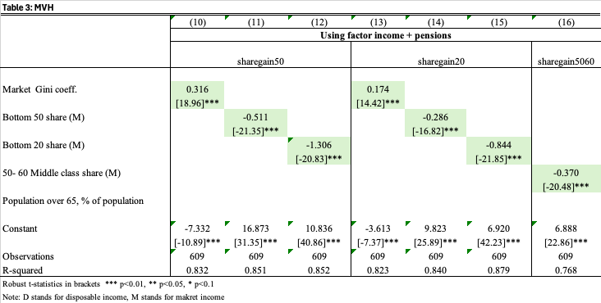
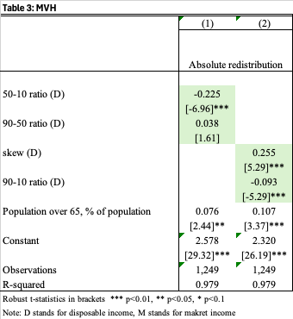
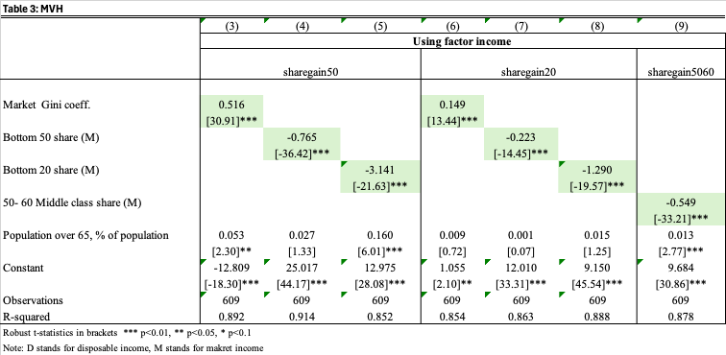
Chapter 3 - Results and contribution
Revisits the traditional MVH Framework:
    Provides a robust empirical test of the MVH using different data and income definitions (market vs. disposable income) unavailable in prior studies.
    Accounts for income distribution structure rather than relying solely on inequality measures as most related research.
    Confirms the MVH relationship, yet reveals that policy responses were insufficient to offset rising inequality (confirming Lupu & Pontusson, 2011 and Milanovic, 2000).

Slide 14
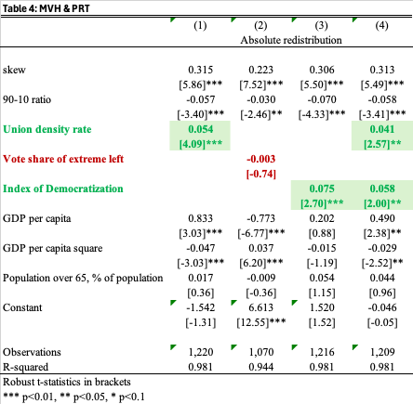
Chapter 3 - Results and contribution
Relaxes the Traditional MVH Assumptions:
    Median voter preferences are not directly translated into policy - The framework is extended by incorporating Power Resource Theory.
      Union density and democratic strength increase redistributive support, while left-wing populism does not significantly affect redistribution (in contrast to Machtei et al., 2025).
      Highlights the Role of Institutions - In countries with stronger welfare states, both inequality and labour market institutions trigger greater redistributive demand, although these countries start from lower inequality baselines. (see results here)

Slide 15
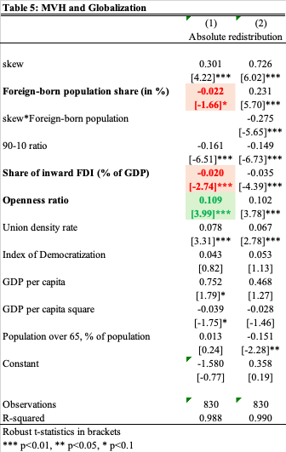
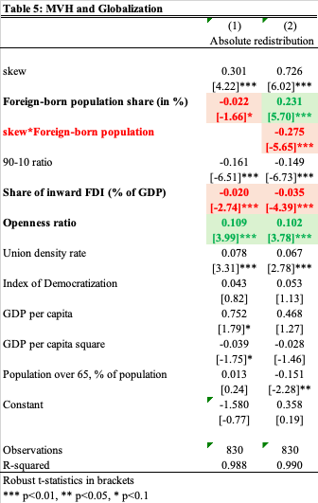
Chapter 3 - Results and contribution
    Voters do not have only income preferences - Introduces Globalization into the MVH Framework
      Trade openness encourages compensatory social spending (supports Compensation Hypothesis).
      Financial globalization constrains fiscal capacity, consistent with findings of previous chapter (Dallinger, 2010; Lupu & Pontusson, 2011; Schwabish et al., 2003),
      Confirms Welfare Chauvinism Hypothesis that immigration reduces support for redistribution (in line with Alesina et al., 2021a, 2021b)
      Immigration weakens the relationship between inequality and redistribution

Slide 16
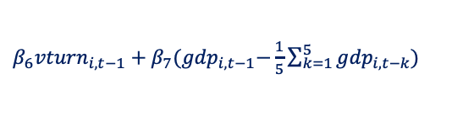

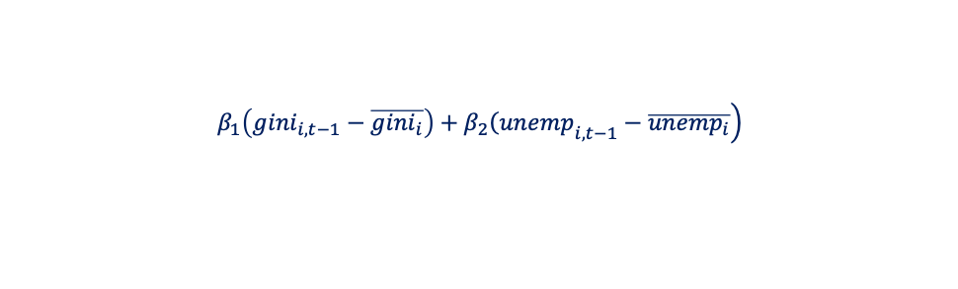
Chapter 4 – Data and methodology
Unequal roots of populism: Testing Rodrik’s hypothesis
  RQ 6
  Sample: Subsample of European OECD countries, 1980–2018
  Main data sources:
    CPDS - Vote share, voter turnout and unemployment rate data;
    Timbro Populism index - vote share data
    SWIID - Gini coefficients;
    KOF globalization indices;
    Correlates of War Project Trade Data Set - imports from China;
    World Bank's WDI database - net migration and GDP data;
    OECD database - share of foreign-born population (as % of total population);
    QOG OECD dataset - Public expenditure on education (as % of GDP);
    Varieties of Democracy (V-Dem) - democratization index.
  Quantitative methods:
    Fixed Effect (one-way)
Voter turnout
GDP deviation
Vote share of right-wing pp
Vote share of left-wing pp
$β_{6}{vturn}_{i,t−1}+β_{7}{(gdp}_{i,t−1}−\frac{1}{5}\sum_{k=1}^{5}{{gdp}_{i,t−k}})$
$${vs}_{it}=α+β_{1}{econ}_{it}+β_{2}{identity}_{it}+β_{3}Z_{it}+C+ε_{it}$$
$$\left.β_{1}\left({gini}_{i,t−1}−\overline{{gini}_{i}}\right)+β_{2}{\left(unemp\right.}_{i,t−1}−\overline{{unemp}_{i}}\right)$$
$β_{3}\sum_{k=2}^{6}{{netmig}_{i,t−k}}+β_{4}{forborn}_{i,t−1}+β_{5}{glob}_{i,t−1}$
Market Gini deviation
Disposable Gini deviation
Unemployment rate deviation
Net migration rate
Share of foreign-born population
Globalization (KOF Trade Globalization index, or
KOF Financial Globalization index, or
Imports from China (% of total imports))

Slide 17
Chapter 4 – Data and methodology
Unequal roots of populism: Testing Rodrik’s hypothesis
Robustness specifications due to methodlogical issues:
Sensitivity of the baseline results to ideological classification of political parties – Timbro database
Voter turnout enodgenity
    Baseline model without voter turnout FE estimation
    Baseline model including voter turnout GMM estimation
The effect of election year on data structure – estimation of the baseline model only for election years.
Alternative model specifications:
The role of education and political populism
$${vs}_{it}=α+β_{1}{econ}_{it}+β_{2}{identity}_{it}+β_{3}Z_{it}+β_{4}{educ}_{it}+C+ε_{it}$$
Trust in institutions and political populism
$${vs}_{it}=α+β_{1}{econ}_{it}+β_{2}{identity}_{it}+β_{3}Z_{it}+β_{4}{corruption}_{it}+C+ε_{it}$$
Systemic differences between countries and political populism
$${vs}_{it}=α+\left(β_{1}{econ}_{it}+β_{2}{identity}_{it}+β_{3}Z_{it}\right)∗nordsoc+C+ε_{it}$$

Slide 18
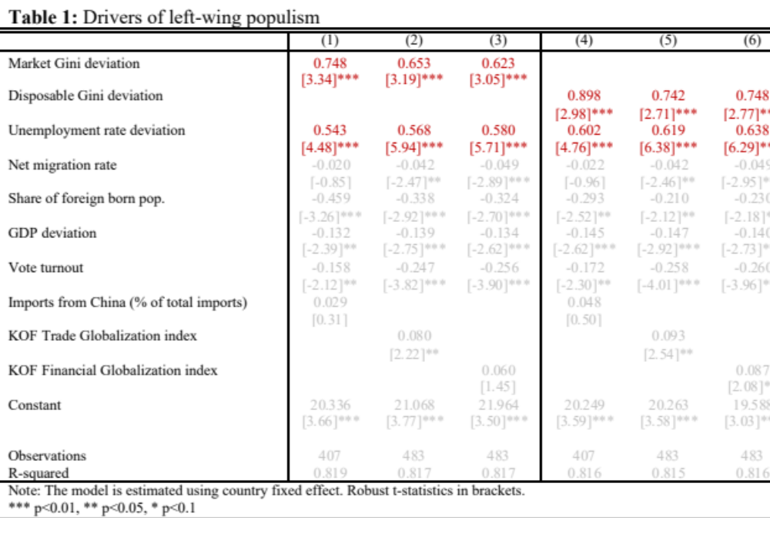
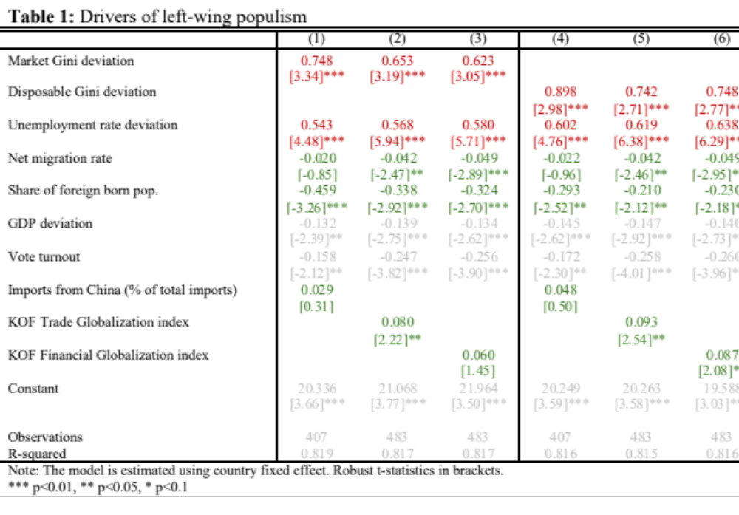
Chapter 4 - Results and contribution
Table 6: Drivers of left-wing populism
    Income inequality and unemployment are main drivers of left-wing populism, immigration and voter turnout decrease support for the left, while trade and financial globalization have small positive, statistically significant effect.

Slide 19
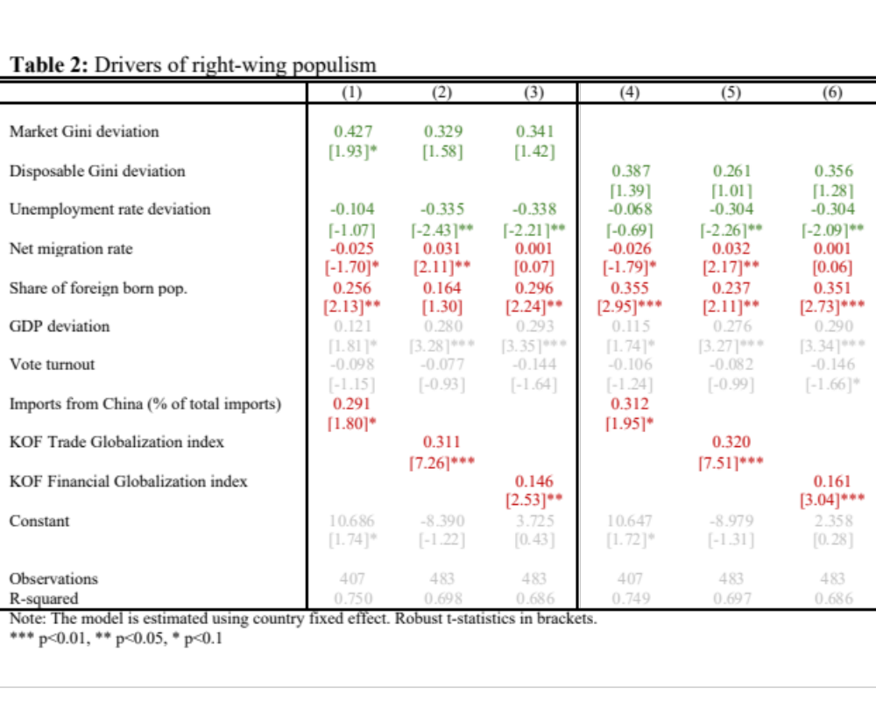
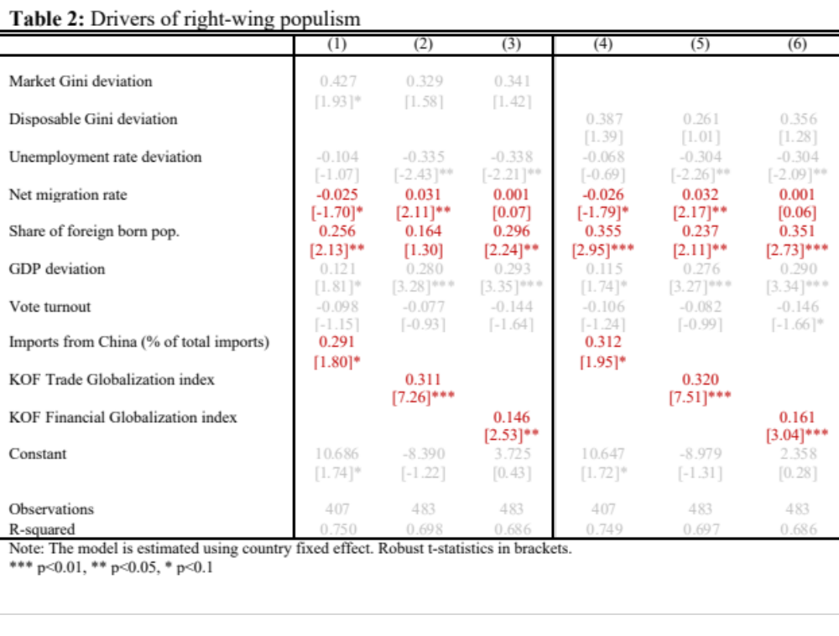
Chapter 4 - Results and contribution
Table 7: Drivers of right-wing populism
    Higher exposure to financial and trade globalization, as well as immigration drive right-wing populism, voter turnout and unemployment decrease support for the right.

Slide 20
Chapter 4 - Results and contribution
First empirical test and confirmation of Rodrik’s hypothesis:
RW populism develops along the identity-based cleavage, driven by immigration and intensified trade.
LW populism increases as a consequence of rising income inequality (especially disposable) and economic hardship.
No comparable macro level studies besides Bergh and Kärnä, 2021 who reach drastically different results.
Related research includes individual-level analysis, often country-specific, related to voter preferences and political outcomes, or focused only one side of political spectrum.
Financial globalization
Education
Immigration
Income inequality
Education
Unemployment
Trade
Corruption
Corruption
Voter turnout
Unemployment
Voter turnout
Left-wing populism
Right-wing populism

Slide 21
Contribution to the literature
Chapter 2
Empirical quantitative studies on income inequality
Chapter 3
Empirical quantitative studies on income inequality
Empirical quantitative studies on income inequality Redistribution
Chapter 4
Political economy
Macro level interdisciplinary quantitative studies
Political economy
Globalization
Globalization
LITERATURE
Finds significant joint importance of Technology Globalization and Policy in shaping inequality outcomes
Highlights dual equalizing effect (direct and indirect – cushioning) effect of policy related drivers
Empirically confirms functioning of traditional MVH framework, but not to the extent sufficient to outweigh inequality increase
Extends MVH framework to include PRT and globalization
Empirically confirms that RW populism is driven by globalization related factors, while LW populism is driven by income inequality and economic deprivation
CONTRIBUTION
PUBLICATIONS
Drivers of income inequality in OECD countries: Testing the Milanovic’s TOP hypothesis. Structural Change and Economic Dynamics, 74, 416–440.
Working paper: ”Does median voter still matter? A novel approach to median voter hypothesis”
Working paper: ”From Income Disparities to
Political Polarization: The Unequal Roots of Populism”
Technological progress
Political Populism
Income inequality
Policy
(II)
Globalization
(I)
(I)
(I)
(III)
(II)
(III)
CAUSES
CONSEQUENCES
(II)
Notes:
Paper 1 aim
Paper 2 aim
Paper 3 aim -
Guided by Rodrik’s (2018) cleavage framework, we test the hypothesis that economic hardship drives support for left-wing populism (income-based cleavage), whereas exposure to globalization, through trade and immigration, drives right-wing populism (identity-based cleavage).
We study to what extent growing income inequality, openness to trade, financial globalization, and immigration could explain electoral behavior in the new political era.
The aim of this paper is to fill a gap in the existing literature by providing a macro-level, multidisciplinary analysis of structural drivers of left and right-wing populism in Europe, offering a novel alternative to dominant individual-level approaches.
Most existing studies either focus on single-country cases or rely on individual-level data, limiting their comparability with our macro-level, cross-country analysis (see reference list). The literature that decides to take macro-level methodological path is limited, and our findings drastically differ (Bergh & Kärnä, 2021).

Slide 22
PRESENTATION OUTLINE
MOTIVATION
FURTHER RESEARCH AND LIMITATIONS
RESULTS AND CONTRIBUTION
POLICY IMPLICATIONS
RESEARCH GAP AND AIMS

Slide 23
Policy implications
The economic and political outcomes of globalization and technological change are neither uniform nor inevitable.
Rising inequality should be viewed as a policy and institutional failure, rather than an inevitable outcome of capitalist market forces.
Policies that fail to adapt to new economic realities risk eroding social cohesion and fuelling political extremism.
The Fourth Industrial Revolution and deeper global integration will amplify both opportunities and risks.
The challenge is not to resist globalization or technological progress, but to design institutions that mediate their effects fairly.
Building strong welfare states, progressive tax systems, and inclusive labour-market institutions is essential to share the gains more broadly.
Such frameworks not only improve income distribution but also enhance democratic resilience by reducing polarization and restoring trust in institutions.

Slide 24
PRESENTATION OUTLINE
MOTIVATION
FURTHER RESEARCH AND LIMITATIONS
RESULTS AND CONTRIBUTION
POLICY IMPLICATIONS
RESEARCH GAP AND AIMS

Slide 25
Further research and limitations
Despite multiple identification strategies, this thesis does not claim causality due to data limitations and process complexity. Findings should be interpreted as robust correlations consistent with, but not proving, causal mechanisms.
Data limitations: Cross-country analysis, needed to assess policy and political effects, is constrained by lack of comparable indicators, especially for technological progress, AI-driven change and more granular immigration data.
Policy design: Need for empirical research on optimal policy mixes balancing efficiency and equity (taxation, welfare, labour market policies).
Global dimension: Examine the potential of tax harmonization, transnational regulatory frameworks, and international cooperation in curbing inequality.
Financial globalization: Complexity of international capital flows limits traditional taxation and redistributive capacity and motivates further analysis that would yield sound domestic and international policy.
Labour markets and AI: Study how AI and platform work reshape labour markets and propose mechanisms for equitable adaptation.
Wealth vs. income inequality: Investigate their distinct and interconnected effects on growth and stability.
Expanding the time span of the analysis: COVID-19 and income inequality.
Interdisciplinary approach: Combine economics, political science, and sociology to better capture institutional and behavioural dynamics.

Slide 26
Thank you
danijela.lazovic@hotmail.com

Slide 27
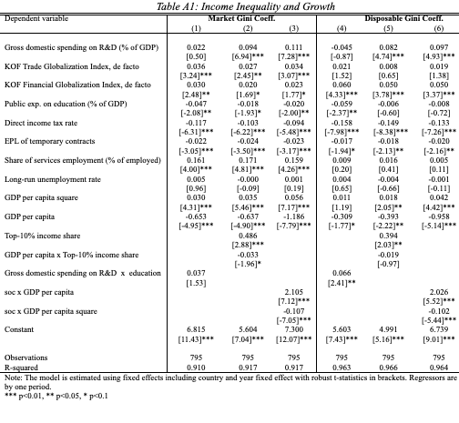
Supplementary analysis – Chapter 2

Slide 28
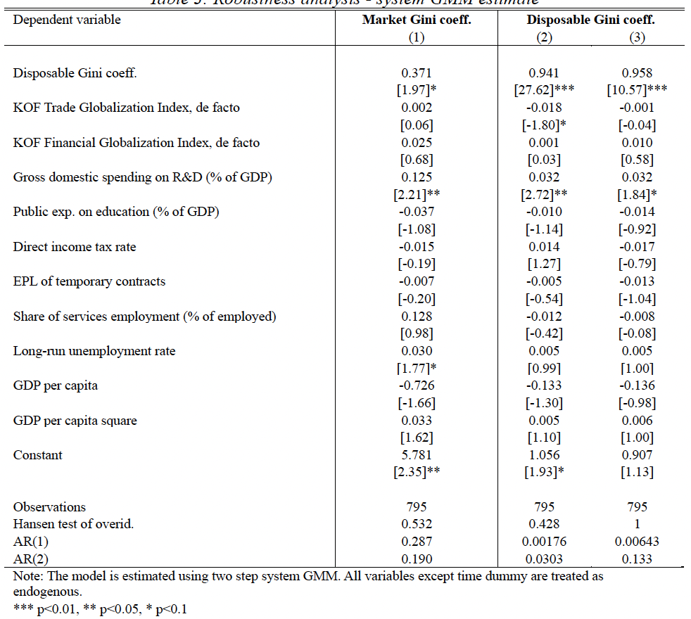
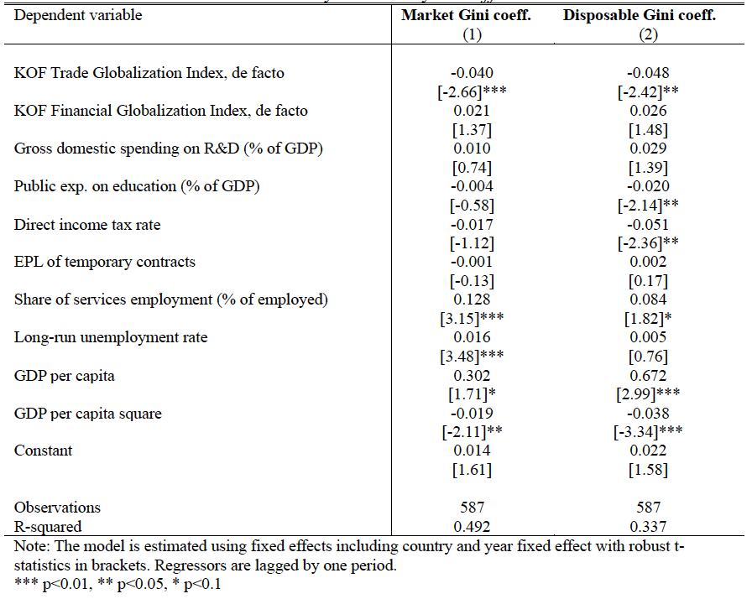
Robustness analysis - Chapter 2
Table A2: Robustness analysis - system GMM estimate
Table A3: Five-year difference estimates

Slide 29
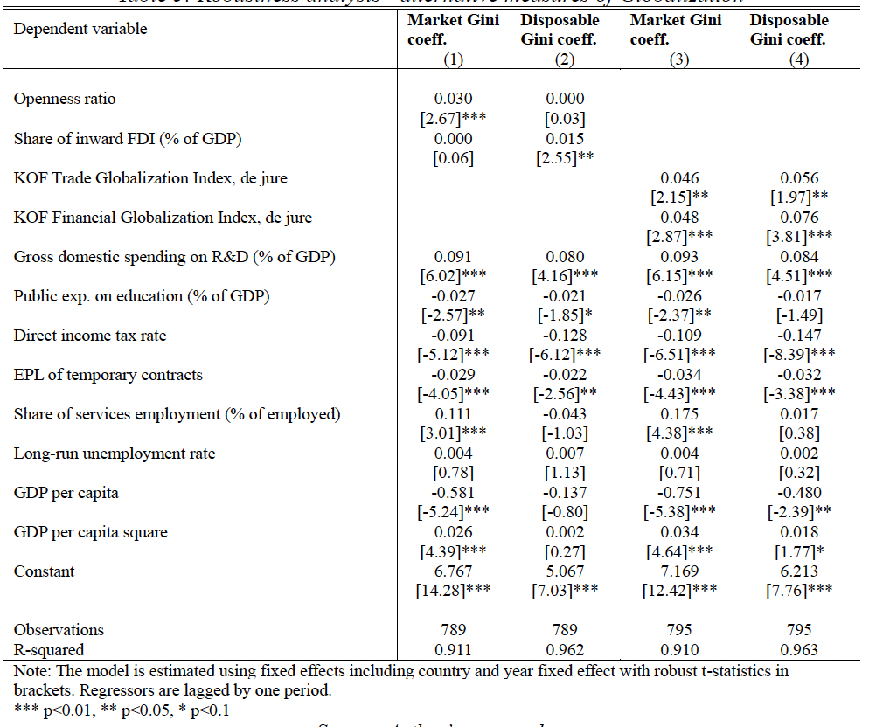
Robustness analysis - Chapter 2
Table A4: Alternative measures of Globalization

Slide 30
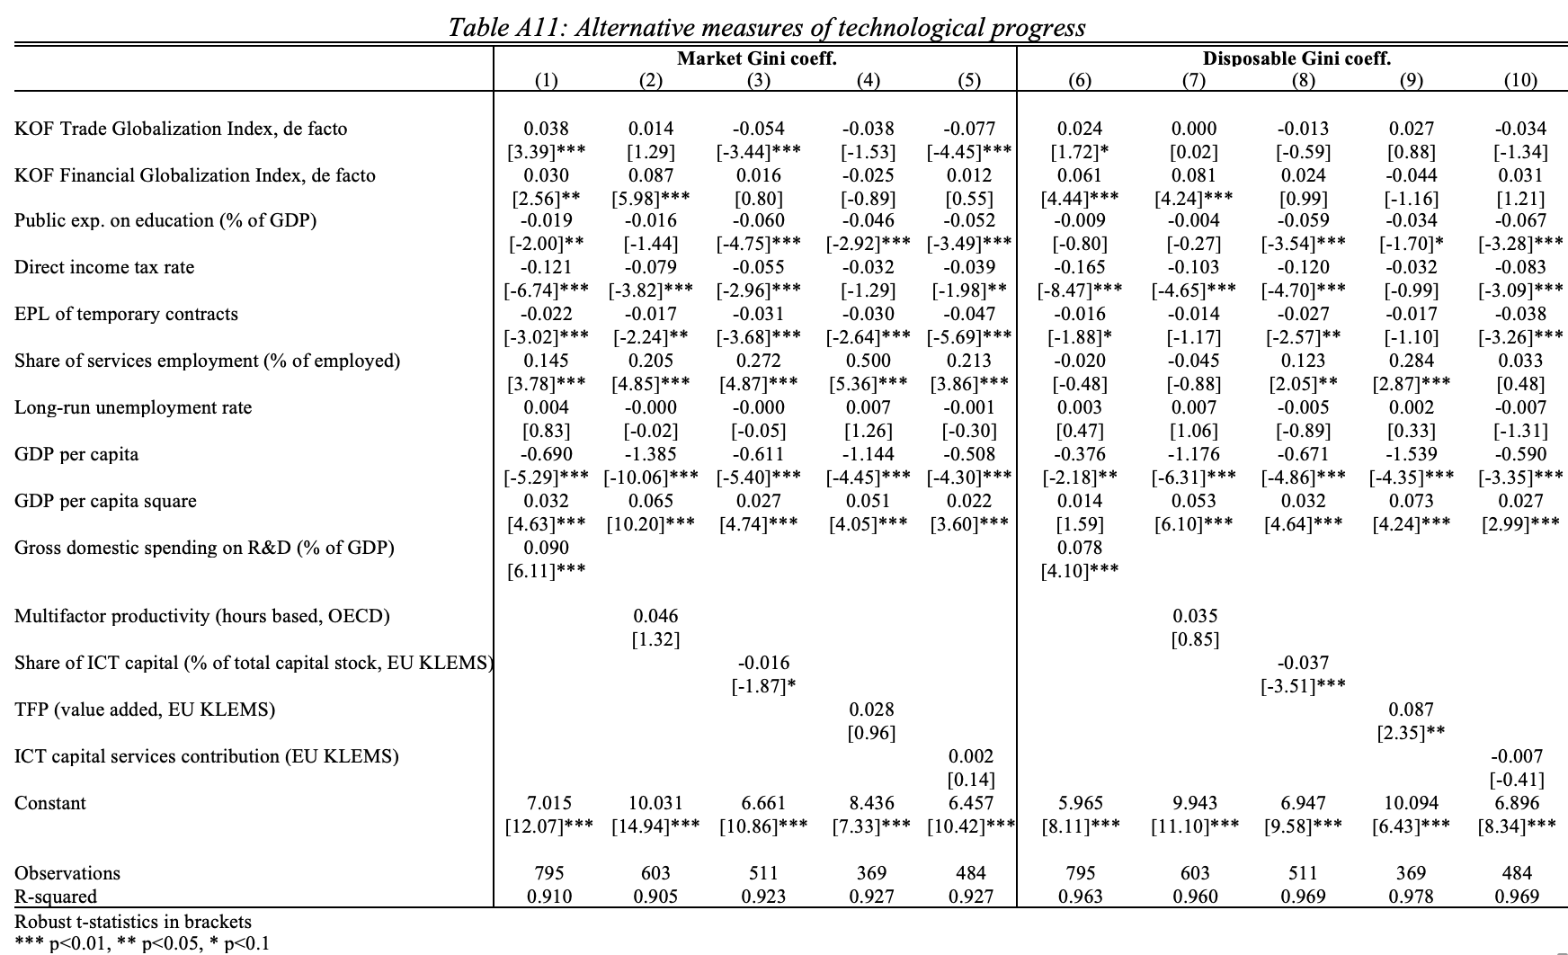
Robustness analysis - Chapter 2
Table A5: Alternative measures of Technological progress

Slide 31
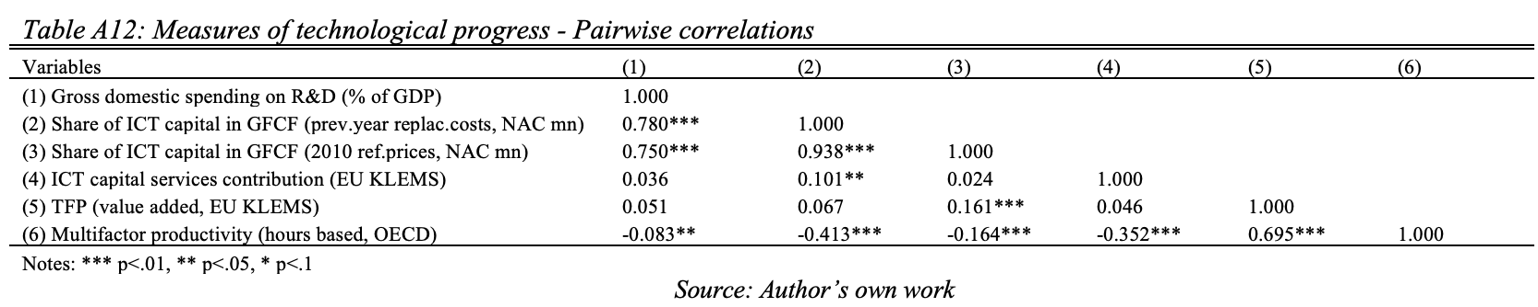
Robustness analysis - Chapter 2
Table A6: Measures of Technological progress – Pairwise correlation
Additional robustness tests
Pooled OLS, regressors lagged by one period
Only country fixed effect, regressors lagged by one period
Country and year fixed effect, regressors lagged by 2 periods
Different definitions of trade with China
SWIID vs EHII
Multiple imputation adjustments
Impact of pensions on benchmark estimates - additional control variable

Slide 32
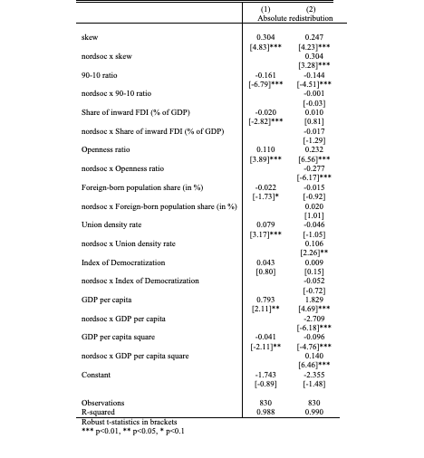
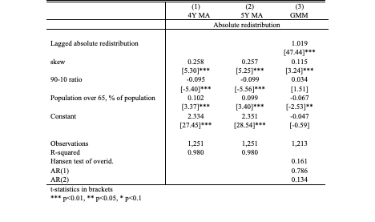
Robustness analysis - Chapter 3
Table A8: MVH and welfare state regimes
Table A7: Baseline model different estimation methods

Slide 33
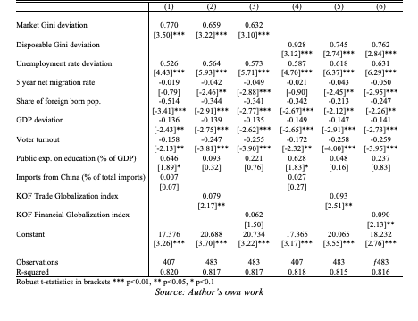
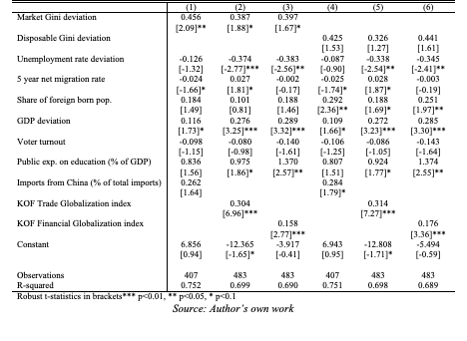
Additional analysis - Chapter 4
    Education is consistently linked to higher populist support.
Table A9: Drivers of left-wing populism – controlling for education
Table A10: Drivers of left-wing populism – controlling for education

Slide 34
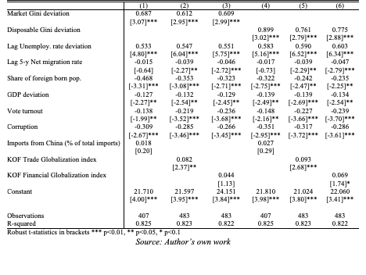
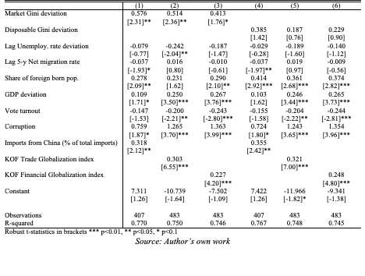
Additional analysis - Chapter 4
    Corruption has an asymmetric effect. It decreases support for the left, but increases support for the right.
Table A11: Drivers of left-wing populism – controlling for corruption
Table A12: Drivers of left-wing populism – controlling for corruption

Slide 35
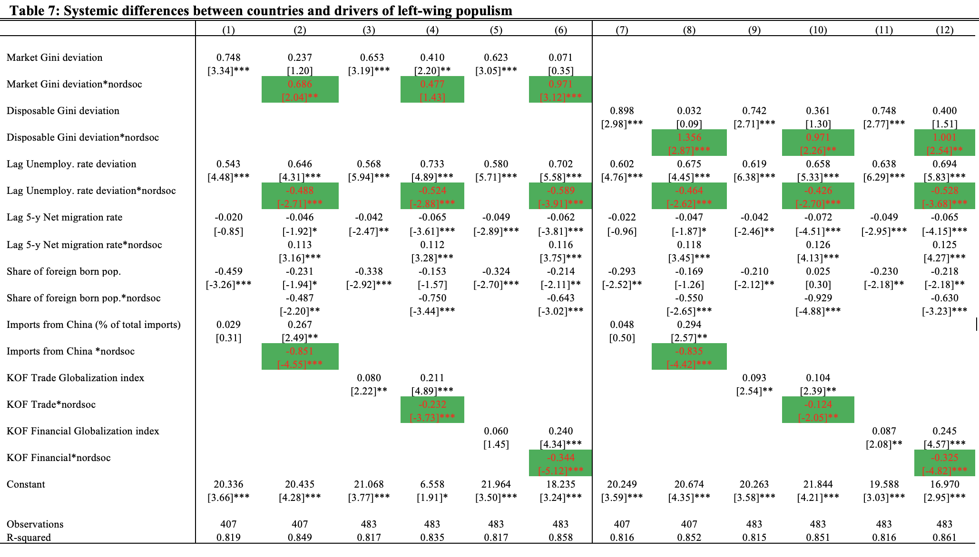
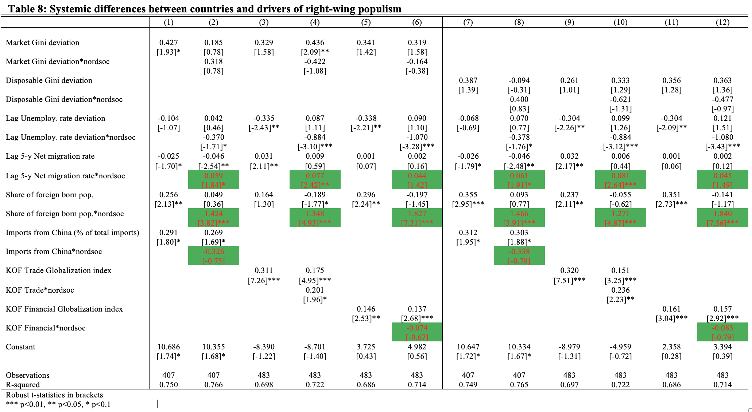
Additional analysis - Chapter 4
Table A13: Systemic differences between countries and populism
    Welfare regimes moderate the relationship between populism and its key drivers.

Slide 36
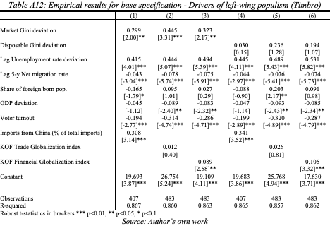
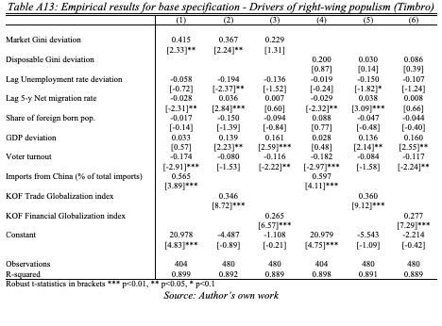
Robustness analysis - Chapter 4
Table A14: Empirical results for base specification - Drivers of left-wing populism (Timbro)
Table A15: Empirical results for base specification - Drivers of right-wing populism (Timbro)
    We confirm our results for all variables except immigration and we only find statistically robust effect of market inequality.
    The difference in the results is driven by the different classification of right-wing parties, especially in the first two decades of our sample, in countries that exhibited large increase in immigrant population and right-wing populist vote share since 2010.

Slide 37
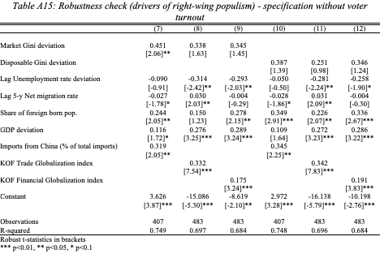
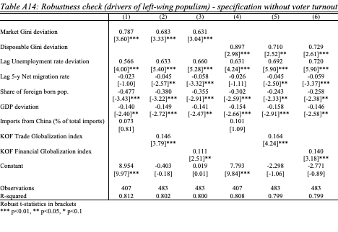
Robustness analysis - Chapter 4
Table A16:Robustness check (drivers of left-wing populism) –
specification without voter turnout
Table A17:Robustness check (drivers of right-wing populism) –
specification without voter turnout
    Magnitude and significance of remaining estimated coefficients are not drastically affected.

Slide 38
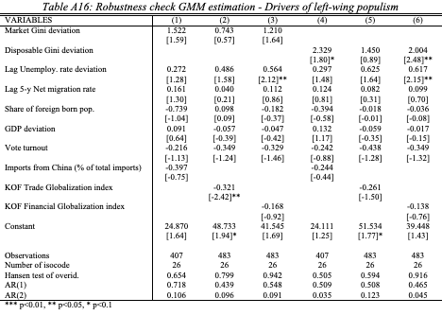
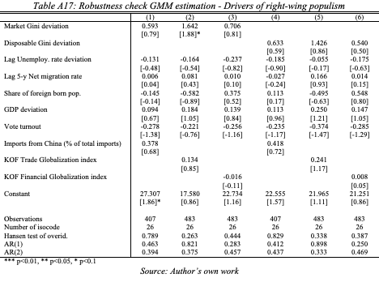
Robustness analysis - Chapter 4
Table A18:Robustness check GMM estimation - Drivers of left-wing populism
Table A19:Robustness check GMM estimation - Drivers of right-wing populism
    We treat voter turnout, inequality, trade, and immigration as endogenous because predominant support for populist parties can affect these variables
    Generally, confirm the baseline results. However, the statistical insignificance of estimated coefficients is caused by the fact that all limitations regarding the use of GMM discussed in the first Chapter unfortunately remain valid.

Slide 39
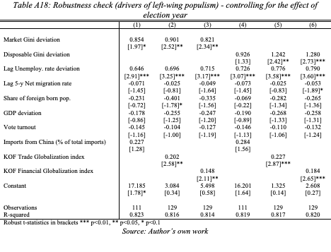
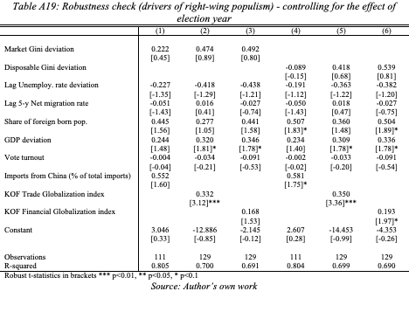
Robustness analysis - Chapter 4
Table A20: Robustness check (drivers of left-wing populism) - controlling for the effect of election year
Table A21: Robustness check (drivers of left-wing populism) - controlling for the effect of election year
    Despite a substantial reduction in panel size, reflected by an almost fourfold decrease in the number of observations, our key results remain robust.
    Although the immigration variable loses statistical significance in nearly all model specifications, largely due to the reduced sample size and the resulting loss of degrees of freedom, the estimated coefficients pertaining to foreign-born population still exhibit the expected sign in models estimating the vote share for both sides of the political spectrum.

