Slide 1
Global Institutional Economics
Part 2.3
Globalization Effects: Good or bad?
Jože P. Damijan
University of Ljubljana

Slide 2
Discussion
Globalization: Good or bad?
Consider advanced countries
Jobs & wages: Manufacturing vs. services
Inequality, middle class, long-run demand
Consider developing countries
Trade, FDI, jobs
Poverty, inequality
Labor standards, child & women labor, environment

Slide 3
Outline
Effects of globalization:
  Open economies grow faster
  Redistributional effects of globalization
    Inter-country: Decrease of Global poverty & inequality
    Intra-country: Increase of intra-country inequality
    Labor market polarization
  Stability sacrificed?
  Shift in global power

Slide 4
Openness & growth

Slide 5
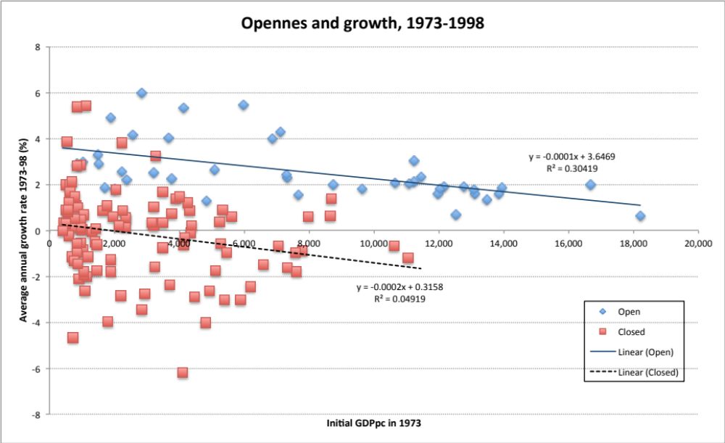
Open economies grow faster
Average growth rate in open econ. bigger by 3.3 ppt
Source: UNIDO

Slide 6
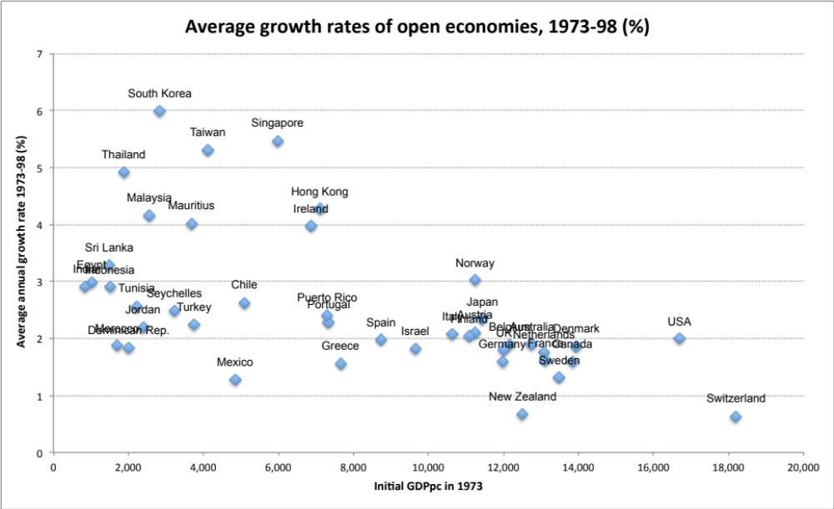
Fastest growing open economies
Asian countries on top
Source: UNIDO

Slide 7
However,
“What you produce/export matters”
(Hausmann, Hwang & Rodrik, 2005)

Slide 8
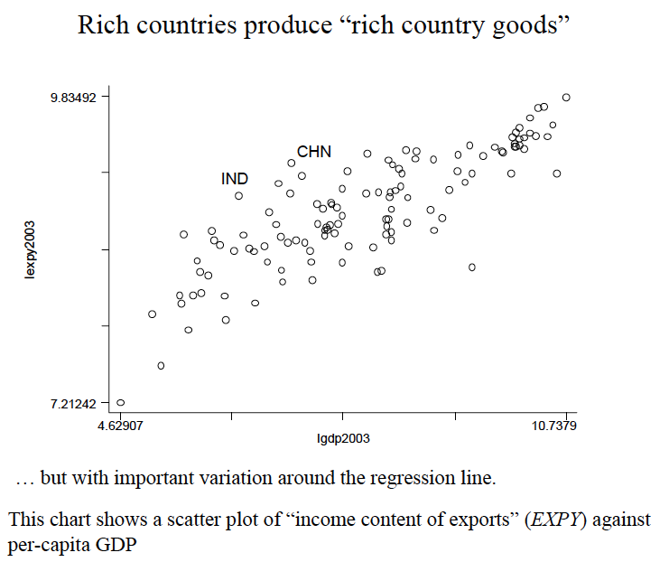
Income content of exports
GDP per capita

Slide 9
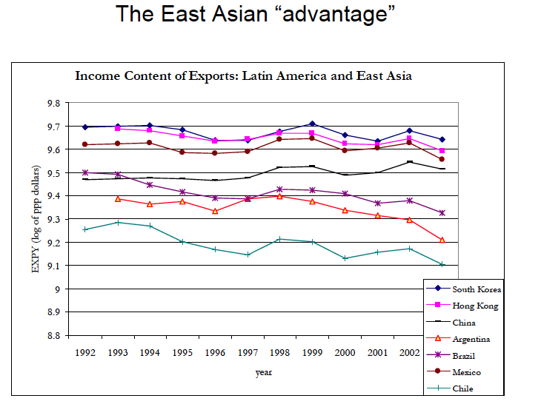
Income content of exports is low and decreasing in Latin America,
  But high and stable or increasing in East Asia

Slide 10
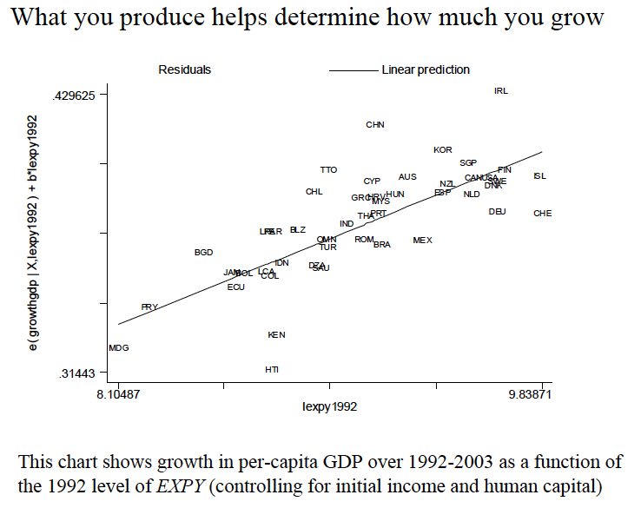
Growth rate of GDPpc 1992-2003
Initial level of income content of exports

Slide 11
Benefits of globalization

Slide 12
Benefits of globalization
Increased choice, lower prices
Greater potential for growth
Increase international economies of scale
Greater employment opportunities
Led to massive increases in wealth for many countries
World poverty decreased
World inequality decreased
  Globally; what about within-countries inequality?

Slide 13
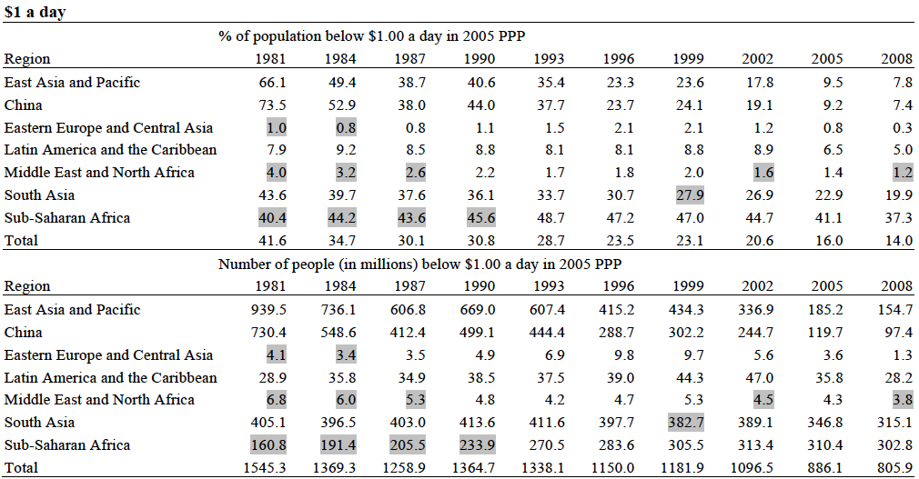
World poverty decreased
% of people living in poverty decreased from 42% to 14%
# of people living in poverty decreased from 1.5 bn to 800 mn
However, mainly effect of China; Poverty increased in Sub-Saharan Africa
Source: Worldbank/Poverty gap.

Slide 14
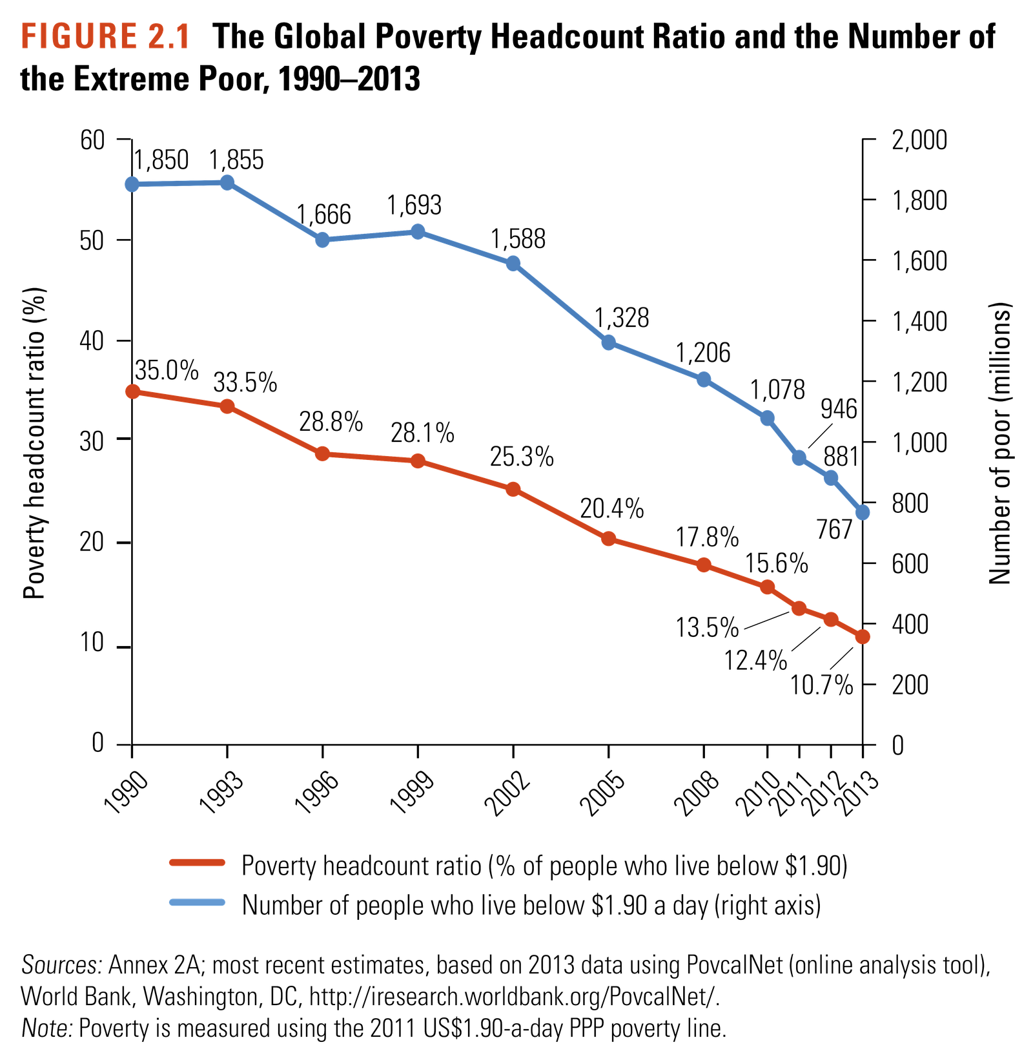
New 2015 WB estimates
… poverty line at $1.90 a day
Between 1990 and 2013 absolute poverty decreased by 1.1 bn people
Percent of people in absolute poverty down from 35% to 11%
Source: Francisco Ferreira, World Bank (2015)

Slide 15
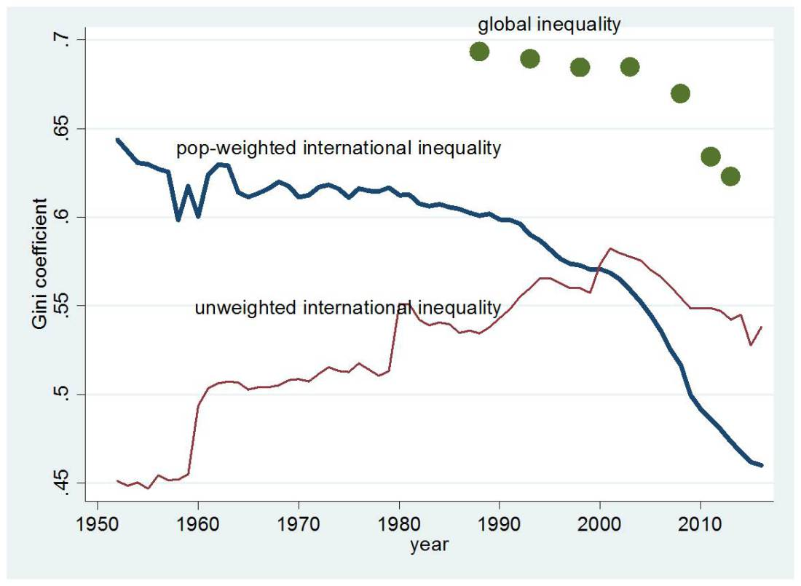
World inequality decreased
… but mostly due to China & India
Concept 2: population-weighted Gini
After 1998, inequality decreased also due to countries other than China
Source: Milanovic (2017)

Slide 16
Who won and who lost with globalization?

Slide 17
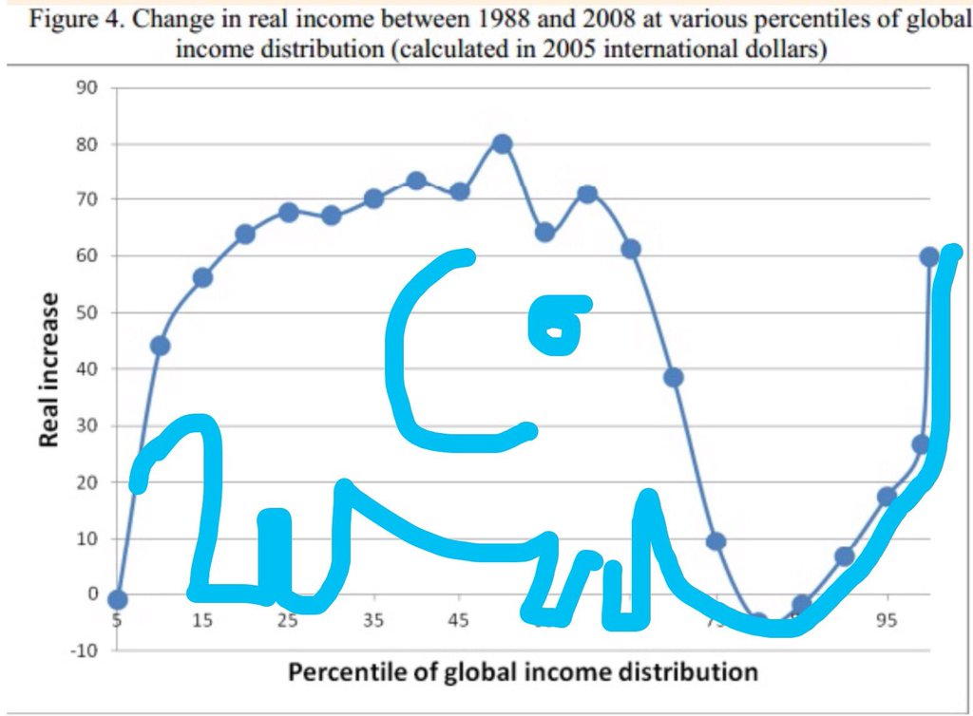
Distribution of gains from globalization
Elephant curve
Elephant curve: The most famous figure about globalization
Source: Milanovic (2012)

Slide 18
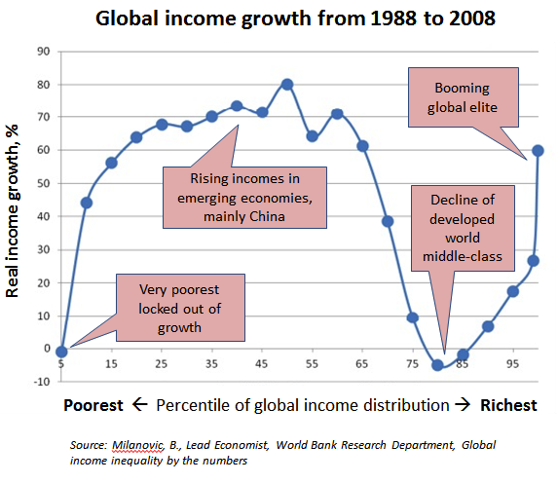

Slide 19
In absolute terms, top-10% account for 68% of total gains

Slide 20
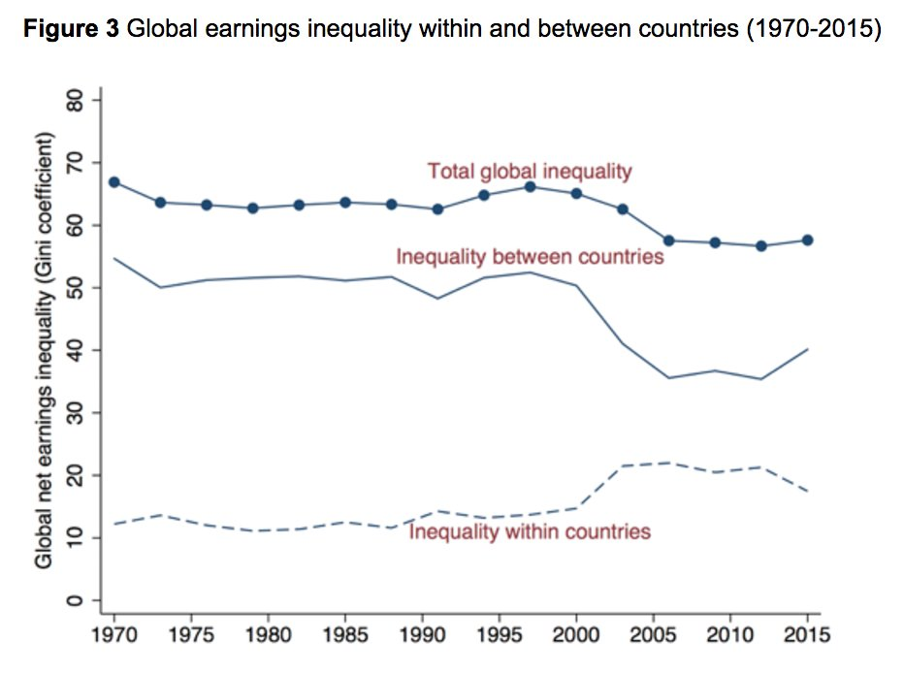
While global inequality down, within country inequality increased
Source: Dabla-Norris, et al (2015)

Slide 21
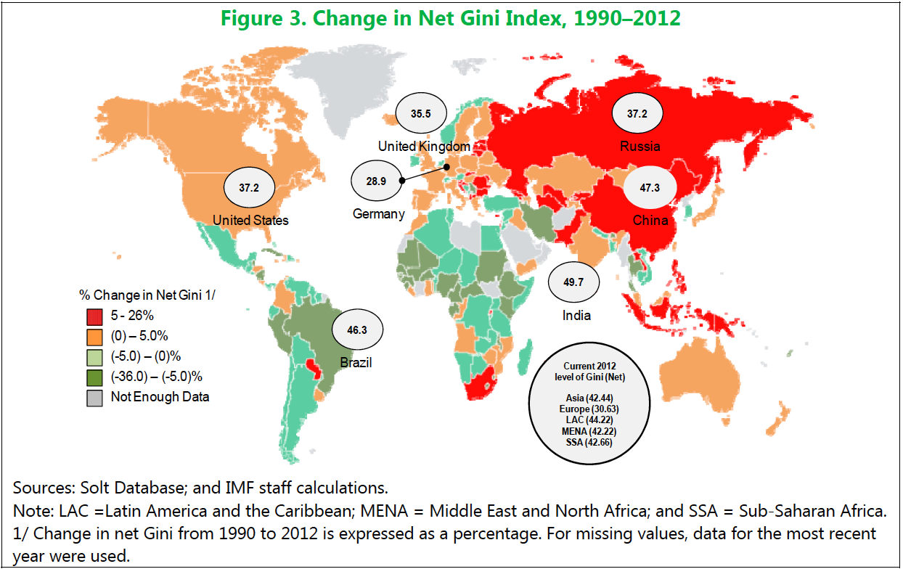
Within country inequality changes
Source: Dabla-Norris, et al (2015)

Slide 22
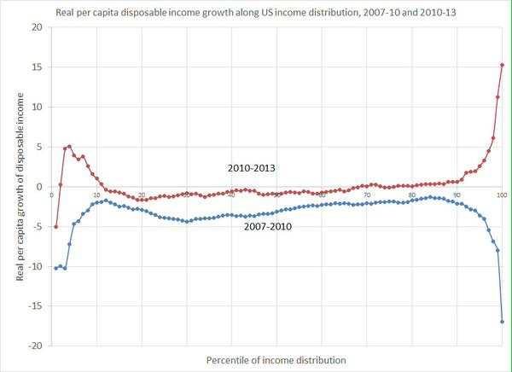
Off: Who benefitted from the recovery (US)
The rich benefited after the crisis …but also the poorest
The rich lost during the crisis (capital assets evaporated)
…but also the poorest

Slide 23
Other benefits (1)
Income inequality for the world as a whole is diminishing
Infant mortality has decreased in every developing region of the world
Life expectancy has almost doubled in the developing world since World War II
Hans Rosling: “200 years that changed the world”

Slide 24
Other benefits (2)
Between 1950 and 1999, global literacy increased from 52% to 81% of the world.
  female literacy as a percentage of male literacy has increased from 59% in 1970 to 80% in 2000.
The percentage of children in the labor force has fallen from 24% in 1960 to 10% in 2000.
Similar increasing trends toward electric power, cars, radios, and telephones per capita, as well as a growing proportion of the population with access to clean water.

Slide 25
The flip side
Developing countries
Unregulated power of large, multi-national corporations, which damage
  the democratic rights of citizens,
  the environment, particularly air quality index and rain forests,
  as well as national governments sovereignty to determine labor rights
    right to unionize for better pay, and better working conditions
    women and child labor

Slide 26
What happened to advanced countries?

Slide 27
The flip side
Advanced countries (1)
De-industrialization trends
Offshoring and the shift to service work: the low cost of offshore workers enabled corporations to move production abroad.
  the laid off unskilled workers are forced into the service sector where wages and benefits are low, but turnover is high.
  widening economic gap between skilled and unskilled workers.
The loss of these jobs has also contributed greatly to the decline of the middle class which is a major factor in the increasing economic inequality
Economic instability

Slide 28
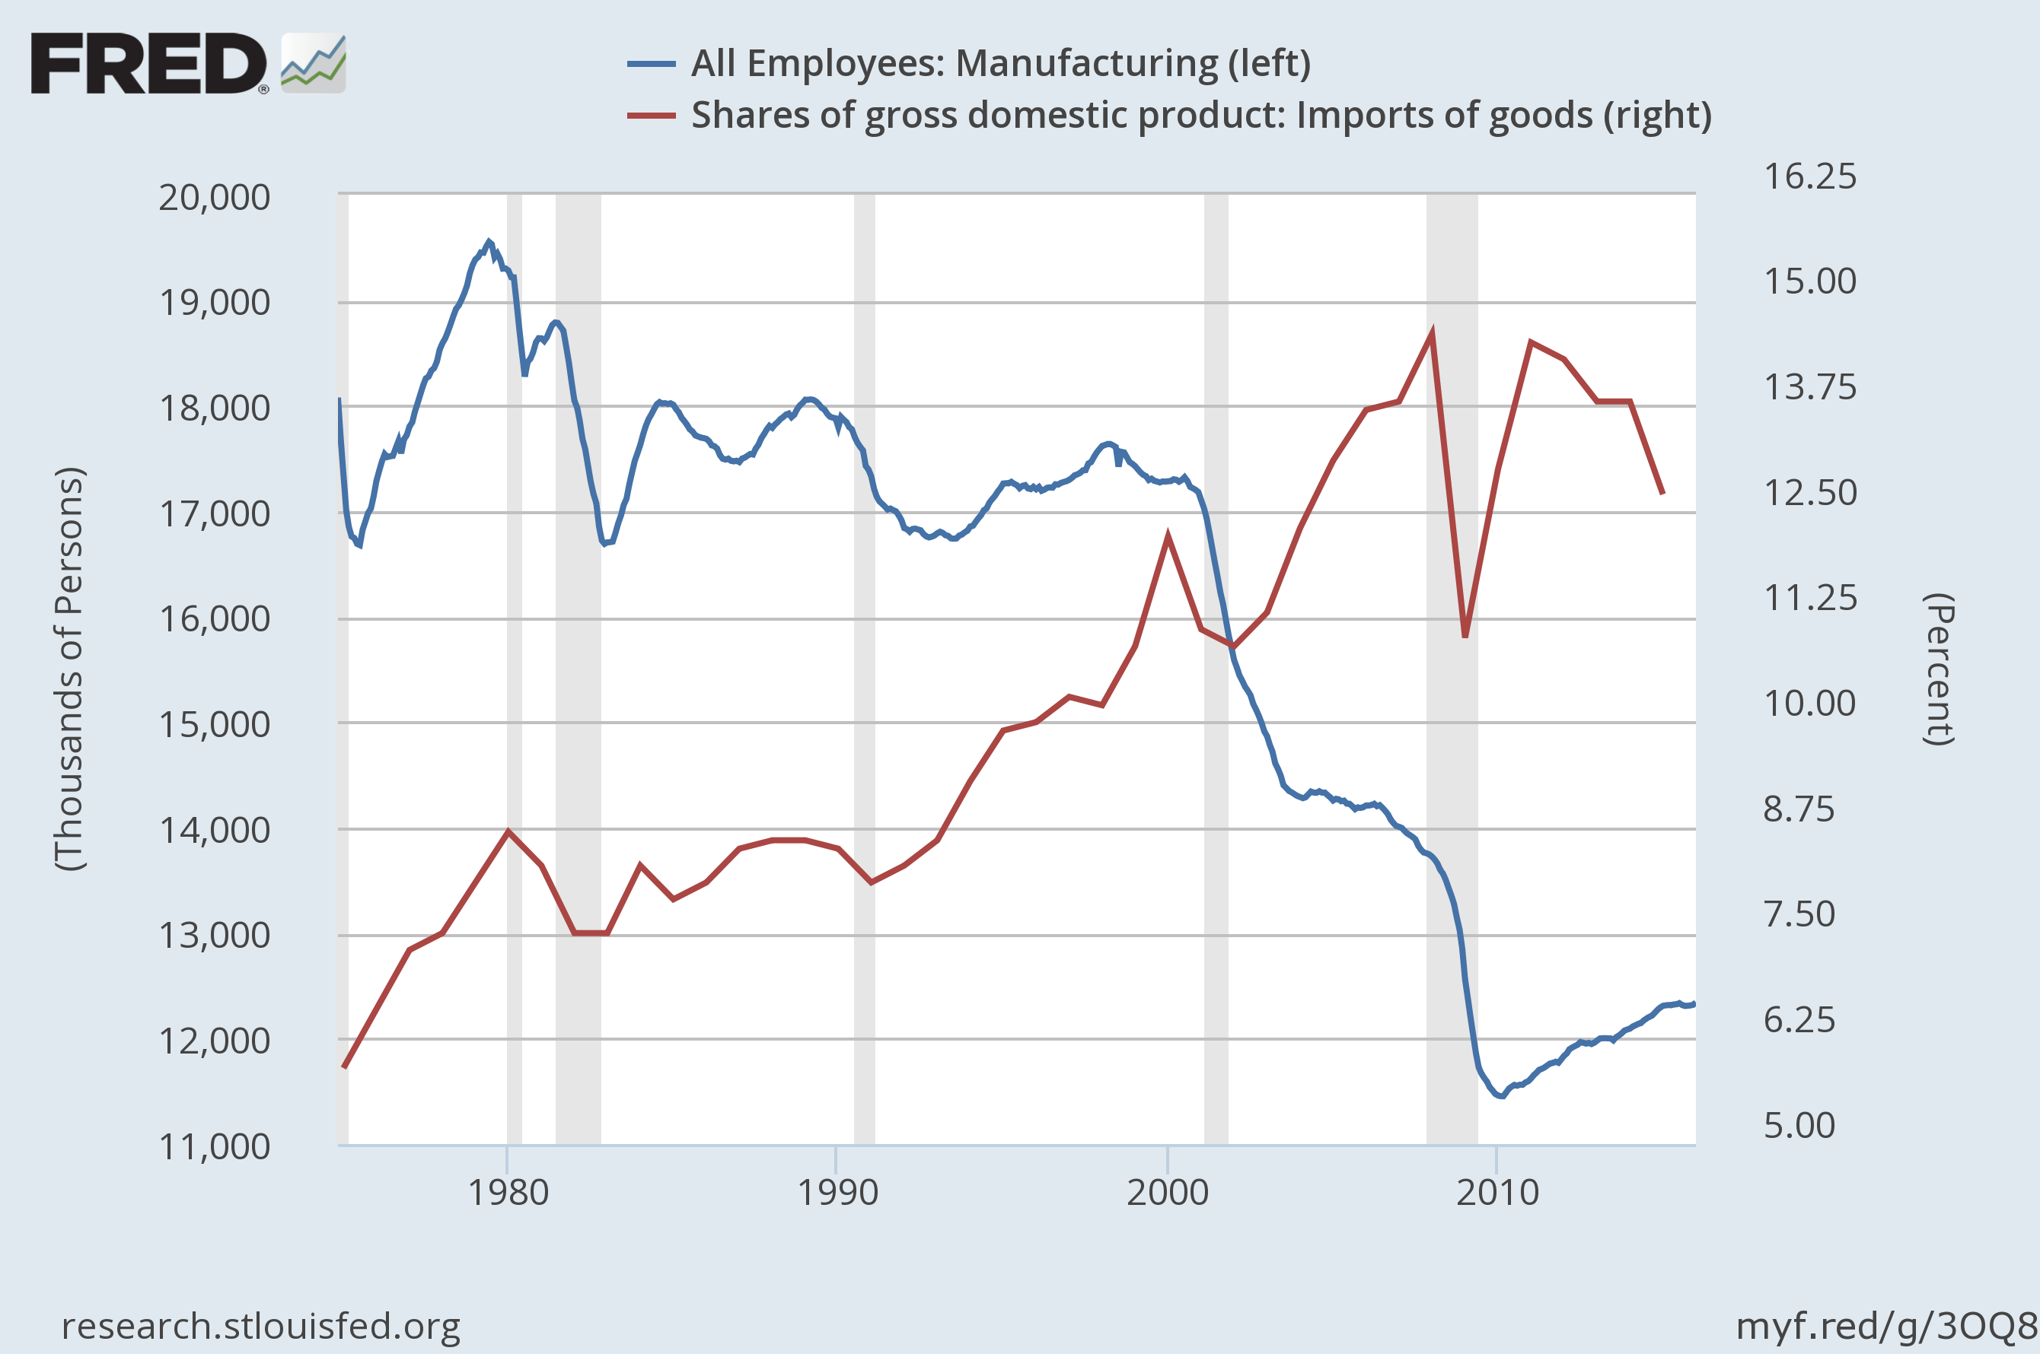
US manufacturing employment & import share
2001: China’s entry into WTO
2001-2008:
- 3.5 mn empl
- 5.7 mn
China shock: after 2001
3.5 mn manufacturing jobs lost between 2001-2007
Notes:
All Employees: Manufacturing
The series comes from the 'Current Employment Statistics (Establishment Survey)'The source code is: CES3000000001
Source: US. Bureau of Labor Statistics
Release: Employment Situation
Shares of gross domestic product: Imports of goods
BEA Account Code: A255RE1For more information about this series, please see http://www.bea.gov/national/.
Source: US. Bureau of Economic Analysis
Release: Gross Domestic Product

Slide 29
EU-15 manufacturing employment & import share
China shock: after 2001
3.6 mn manufacturing jobs lost between 2001-2007
Notes:
All Employees: Manufacturing
The series comes from the 'Current Employment Statistics (Establishment Survey)'The source code is: CES3000000001
Source: US. Bureau of Labor Statistics
Release: Employment Situation
Shares of gross domestic product: Imports of goods
BEA Account Code: A255RE1For more information about this series, please see http://www.bea.gov/national/.
Source: US. Bureau of Economic Analysis
Release: Gross Domestic Product

Slide 30
The flip side
Advanced countries (2)
  Effects on employment in US (BLS study, 2011)
    6 million jobs lost in U.S. manufacturing between 1979 and 2007 (from 19.6 to 13.7 million),
    more than half of it after 2001 (trade liberalization with China)
Effects of globalization on wages in US (BLS study, 2001)
    in the period 1979-1999, 31% of those who lost a job due to trade were not fully re-employed.
    only 36% of the displaced workers were able to find a new job with matching or higher wages,
    55% were at best working for 85% of their former wages,
    and 25% were working for 70% or less of their former wage

Slide 31
Explanation
“China shock” (Autor, Dorn & Hanson, 2013, 2016 )
  Rising imports from China cause higher unemployment, lower labor force participation, and reduced wages in local labor markets that house import competing manufacturing industries
  1/4 of aggregate decline in U.S. manufacturing employment is due to the rise of Chinese import penetration
  Similar findings for Spain, Germany, Norway and Denmark
    Donoso et al. (2014), Dauth et al. (2014), Balsvik et al. (2013), Keller & Utar (2016)

Slide 32
Importing political polarization
Economic polarization seems to affect political polarization:
  Autor et al (2016b) show that in regions more severely hit by Chinese shock political polarization rises (“importing political polarization”)
  Congressional elections 2010: in trade exposed districts voters vote more extreme – i.e. moderate representatives removed by Republican or liberal democrats
  Matched with other trends (increased inequality, austerity, migrations) it gave rise to popular discomfort and populist movements
    Syriza, Trump, Orban, Kaczynsky, Brexit, AfD, NF, 5* …
Policy implications
  Dealing with globalization redistribution effects:
    Strengthening social, welfare and active labor market policies to compensate the “losers” and help finding jobs with matching wages
  What about globalization per se ?

Slide 33
Other consequences
Stability undermined

Slide 34
The flip side
Advanced countries (3)
Global imbalances in trade and capital flows starting in the latter half of the 1990s
These imbalances reflected a chronic lack of saving relative to investment in the US and other industrial countries,
  combined with an extraordinary increase in saving relative to investment in many emerging market nations.
Ben Bernanke (2009)

Slide 35
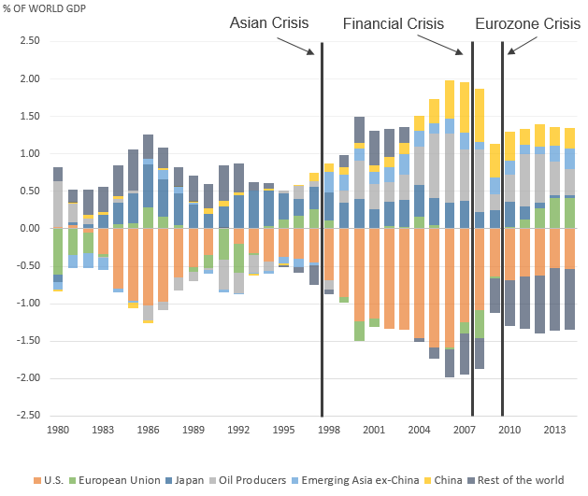
Global imbalances
China
Oil exporters
US
Caballero et al, 2015
Increased after 1991
Oil exporters, China, other Asia

Slide 36
The flip side
Advanced countries (4)
In turn,
  the increase in excess saving in the emerging countries (resulted from rapid economic growth reduced investment rates,
  large buildups in foreign exchange reserves, and substantial increases in revenues by exporters of oil and other commodities) …
  resulting in large capital inflows for more than a decade in the US and some other advanced
  … made the foundations of the current global financial crisis
Ben Bernanke (2005)

Slide 37
Global imbalances and crises
A more complete picture
Capital flows
Outsourcing
(FDI)
Trade
surplus
ASIA
US
Foreign reserves
(After 1997 crisis)
Capital flows
(portfolio)
Capital flows
Financial bubble
Deregulation
Lehman Brothers
… Contagion of
Rest of the world
Stagnant wages
Cheap liquidity after 9/11 (Fed)
Housing bubble

Slide 38
Shift in global political power

Slide 39
Global shift
Has globalization shifted global political powers?
  From US to China?
Chinese Professor Ad: "Now They Work for Us"

