Slide 1
Global Institutional Economics
Part 2.1
Globalization: Evolution & Institutions
Jože P. Damijan
University of Ljubljana

Slide 2
Discussion
What is Globalization?
What defines globalization?
Patterns of globalization
Good or bad?
  For advanced countries?
  Developing countries (China,…) ?

Slide 3
Outline
Evolution:
Trade routes
What defines globalization?
Patterns of globalization
  Global trade, FDI flows, Outsourcing, GVCs

Slide 4
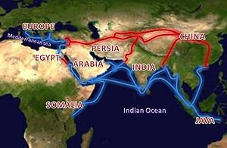
History of globalization
Traits of globalization can be traced to as far back as the Roman Empire
The Silk Road started in China, reached portions of the Persian Empire and ended in Rome
The trade route helped to integrate the three economies of the Han Dynasty, Persian and Roman Empires.

Slide 5
History of Globalization
The word "globalization" has been used by economists since 1981.
The concepts only became popular in the later half of the 1990s.
The first era of globalization (in the fullest sense) during the 19th century:
  rapid growth of trade between the European imperial powers, the European colonies, and the United States.
After World War II, globalization was restarted
  driven by major advances in technology, which led to lower trading costs.

Slide 6
Globalization
Definitions
World wide integration and deepening of economic activities (trade, outsourcing, GVCs)
Integrated production and consumption systems
  Facilitated by IT revolution, liberalization and deregulation
Unprecedented mobility of goods, services, capital and people
Events all over the world strongly interdependent
  i.e. global financial and economic crisis

Slide 7
Drivers of Globalization:
Technological Change
Open markets
  Lower trade barriers
Telecommunications and microprocessors technology that allows ideas to be moved long distances quickly and inexpensively
Transportation technology - lower amounts of money and time foregone to move goods over long distances
The internet and the world-wide web

Slide 8
Patterns of globalization

Slide 9
Global trade flows 1948-2014
What happened 2001 ???
Source: UNCTADstat.
Globalization 1.0 (before 1980): increase by 1.7 t$ (6.4x) in 1970-1980
Globalization 2.0 (1980-2000) : increase by 4.4 t$ (3.2x) in 1980-2000
Globalization 3.0 (after 2000) : increase by 12.5 t$ (2.9x) in 2000-2014

Slide 10
Global production
Global production is organized in global value chains (GVCs)
Half of world trade is due to GVCs
  Moving inputs and final products hence and forth between countries
  Double counting of flows (hence, inflated figures)
GVCs are set up by western corporations,
  either through FDI (direct control) or
  contractional arrangements (more flexible, less costly)

Slide 11
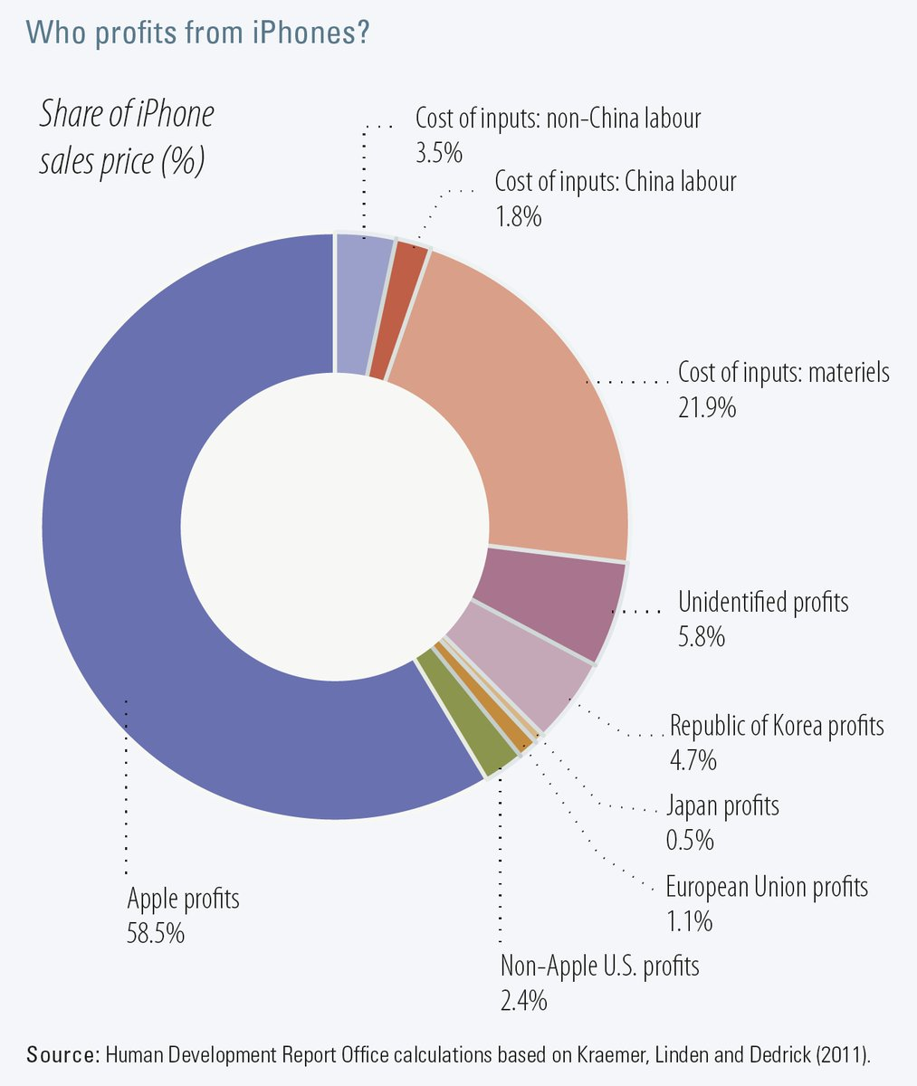
iPhones produced in China’s Foxconn City
China’s workers earning $8 for assembling, $200+ is cost of imported inputs
Apple earns a 60% margin

Slide 12
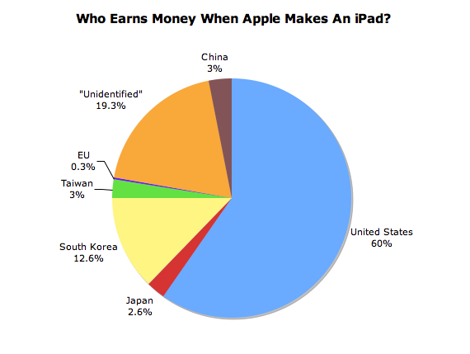
US gets 60% earnings from iPad sales
China gets only 3%
Source: The Atlantic

Slide 13
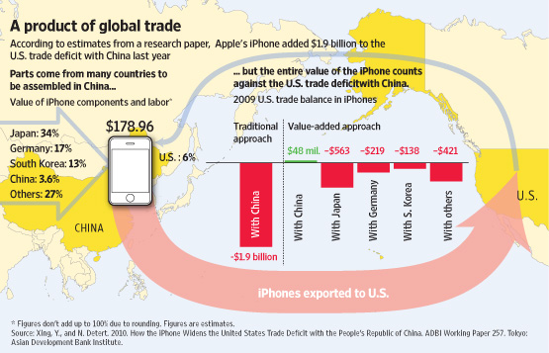
iPhone trade balance
  Moving inputs and final products hence and forth between countries
Which is what inflates the figures of world trade
http://online.wsj.com/article/SB10001424052748704828104576021142902413796.html

Slide 14
Foxconn
Foxconn Technology Group
  headquartered in Tucheng (Taiwan), founder and chairman is Terry Gou
  world's largest contract electronics manufacturer
  fourth-largest information technology company by revenue ($132 bn in 2016)
  largest private employer in China (450 th. in Foxconn city)
Primarily a contract manufacturer
  Worldwide production locations (LatAm, Asia, CEE)
  Major customers
    Acer, Amazon, Apple, Blackberry, Cisco, Dell, Intel, Google, Huawei, HP…)

Slide 15
Export boom in developing countries
China’s entry into WTO (2001)
2.3 t$
200 b$
after 1970: export boom started in Asia, revival after 1985 (from 300 b$ to 4.5 t$)
China export boom only after 2000 (from 200 b$ to 2.3 t$)
GVCs after 2001 contribute most to the boom

Slide 16
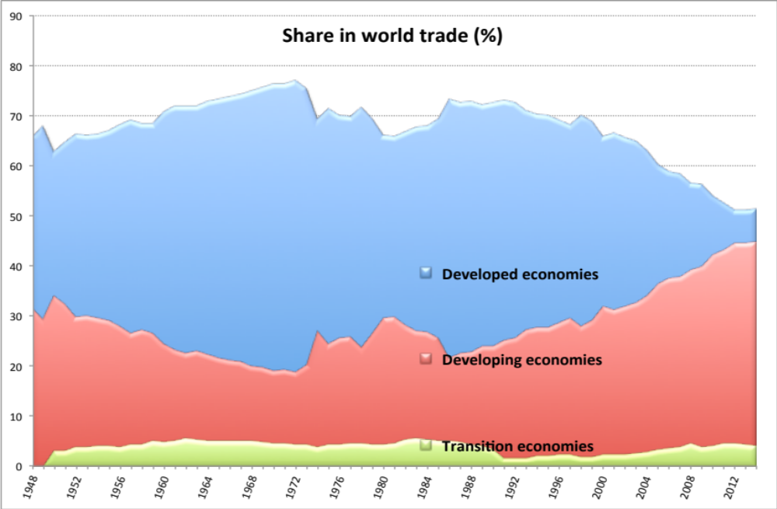
Global trade 1948-2014
77%
51%
45%
21%
Source: UNCTADstat.
until 1972: advanced countries peaked at 77%
1974-1985: oil boom
Rise after 1986: developing up from 21% to 45%, advanced down to 51%

Slide 17
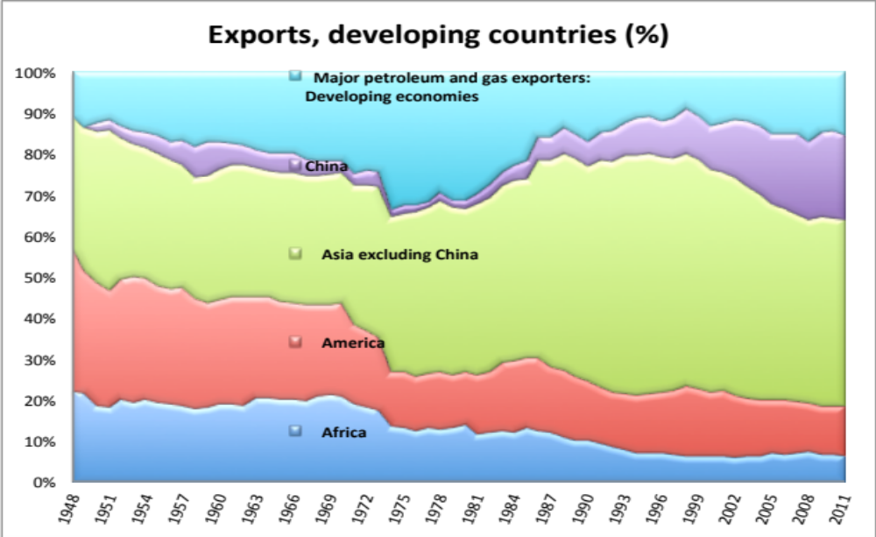
Export shares of developing countries
24%
Africa down to 8%, Latin Am. down to 14%
China up to 24%, other Asia stabilized at 54%
Oil exporters down from 30% to 19%
Source: UNCTADstat.

Slide 18
Global FDI stocks
Similar trends of global FDI stocks as with global exports; boom after 2001
2/3 of global FDI stocks directed to advanced countries
Source: UNCTADstat.

Slide 19
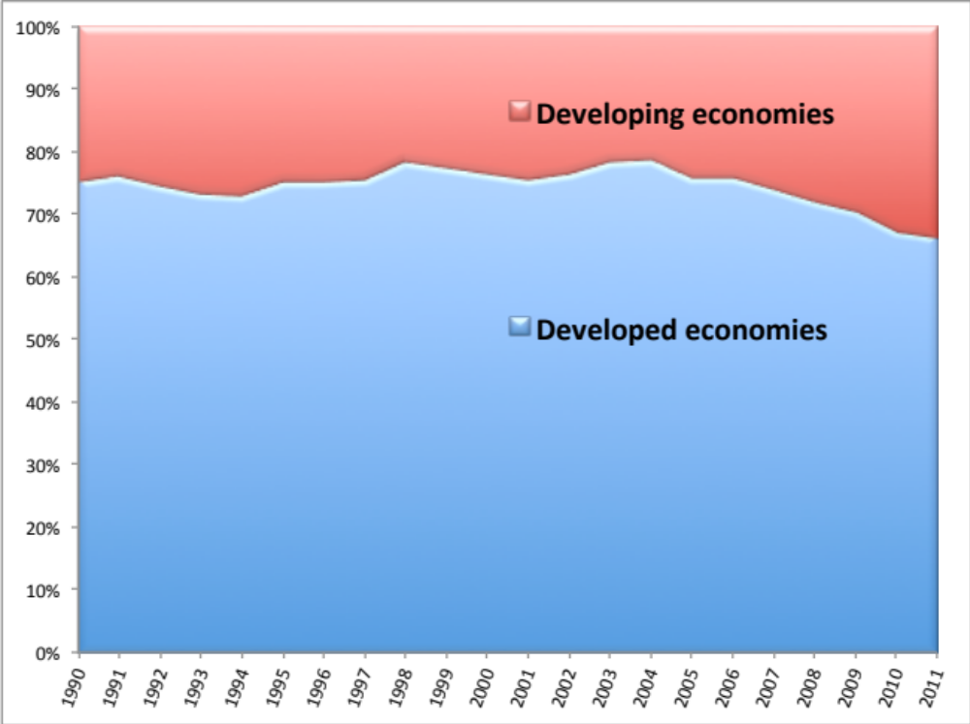
Share in global FDI stocks
32%
68%
Developing c. gain shares after 2004 (from 21% to 32%)
Source: UNCTADstat.

Slide 20
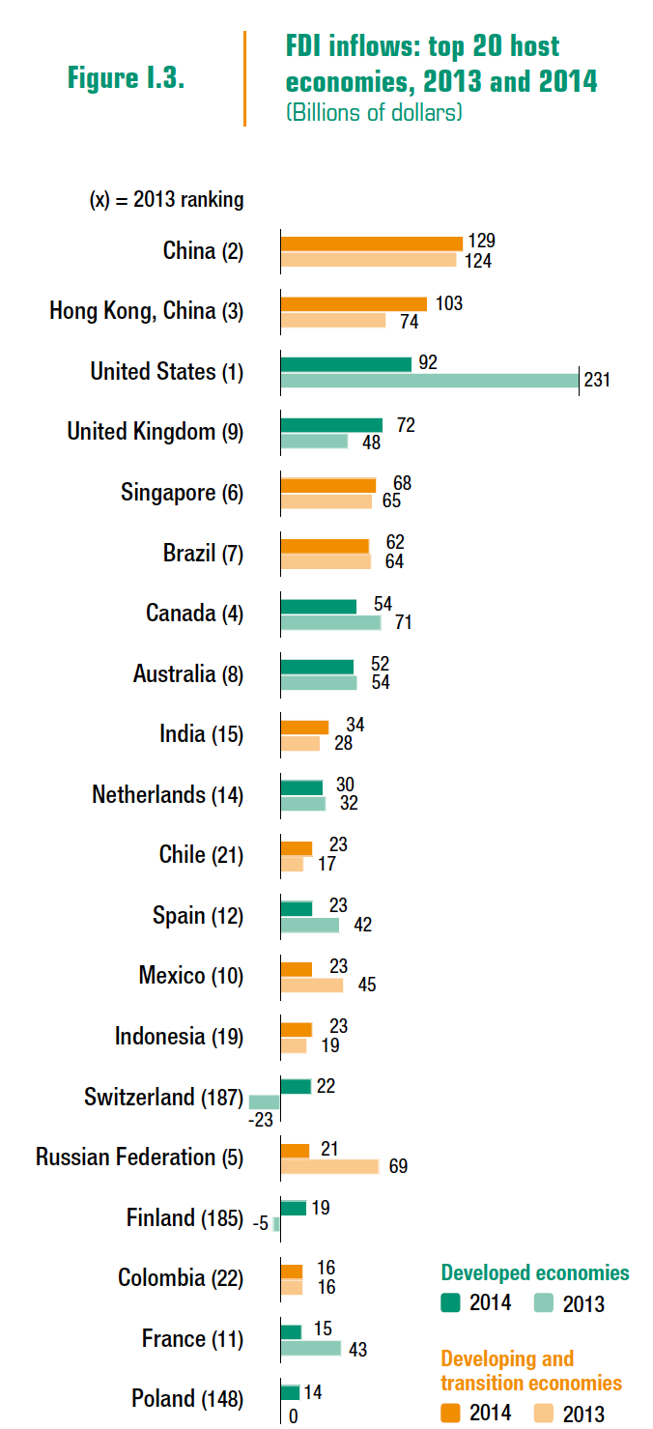
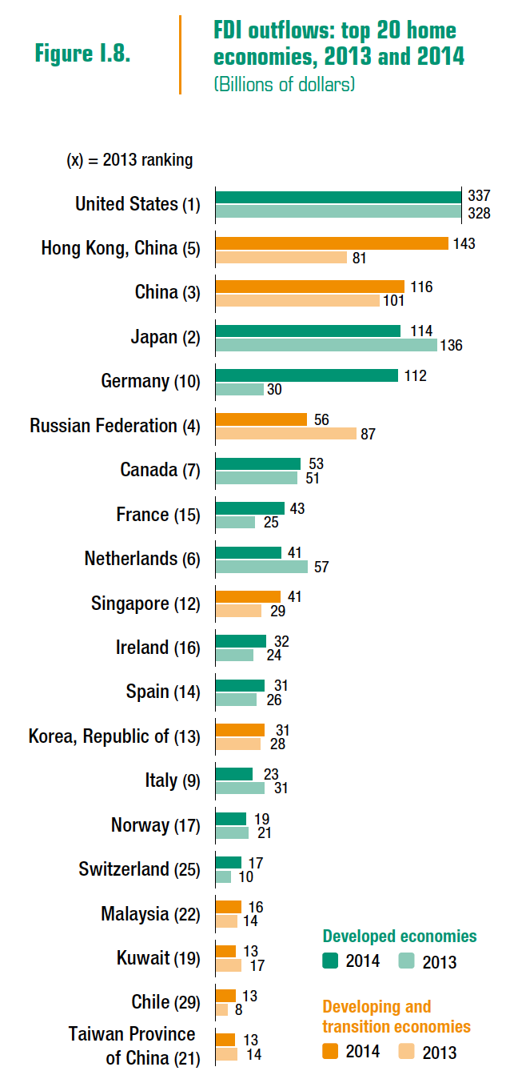
Main players in global FDI flows
Inflows (2014) Outflows (2014)
Same top-3 countries

Slide 21
Key: Positioning within GVCs
What matters in a globalized production pattern
  a position of individual company in the GVC
  overall position of a country (share of domestic value added in exports)
Key is a position on the Smile curve
  to the left or right side of the Smile curve, where higher value added is created
  the middle belongs to countries with low labor cost (production, assembly)
    however, this determines low value added, insecurity of future supplies, possibility of fast replacement in the value chain

Slide 22
Smile Curve
(Source: Business Week International, May 16, 2005)
Added
Value
R&D/Innovation Centre
Global Logistics Center
Standardisation
Higher Added-value and Lower Replacement
Brand
Innovation
Marketing
R&D
Value Creation
Design
Logistics
Manufacture
Assembly
Value-added process
Design
Brand
R&D
Innovation
Manufacture
Logistics
Marketing
Standardisation
Assembly

Slide 23
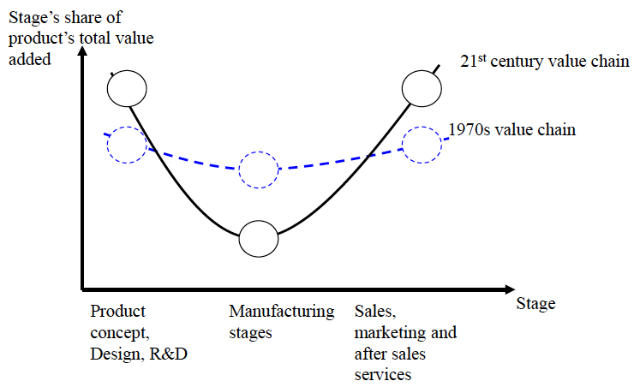
Changing Smile Curve
Smile curve gets deeper
What does this imply regarding the profit sharing ?

Slide 24
When will Asia catch up ?
(will it?)
Hans Rosling: Asia's rise -- how and when

Slide 25
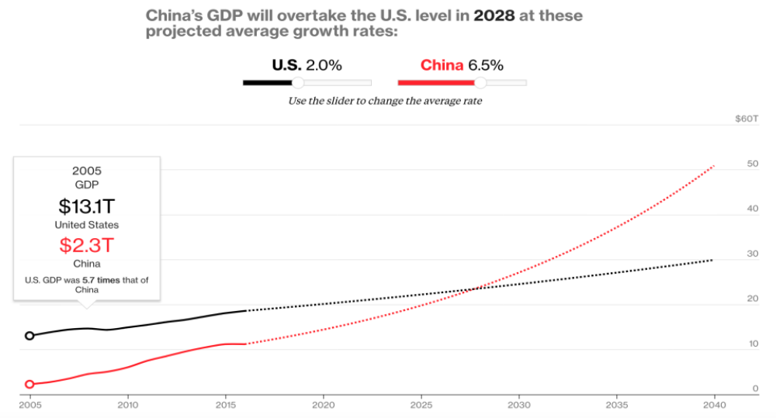
When will China surpass US?
In 2005: US economy was 5.7 times that of China
Source: https://www.bloomberg.com/graphics/2016-us-vs-china-economy/

Slide 26
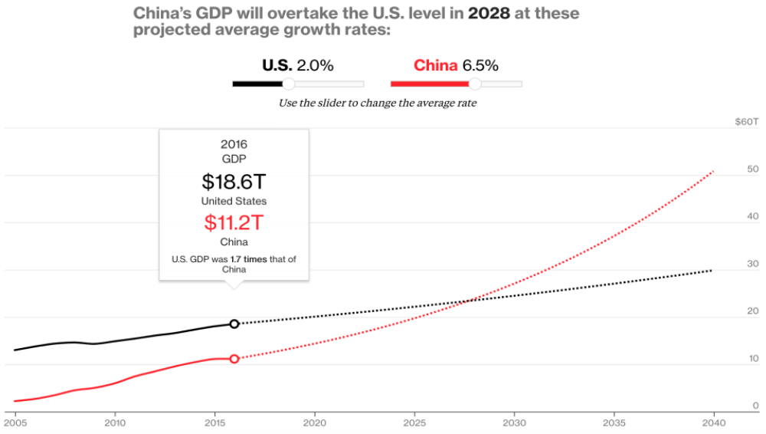
When will China surpass US?
In 2016: US economy was just 1.7 times that of China
Source: https://www.bloomberg.com/graphics/2016-us-vs-china-economy/

Slide 27
When will China surpass US?
At modest 2% US and 4.2% Chinese growth rates, China would surpass US by 2040
Source: https://www.bloomberg.com/graphics/2016-us-vs-china-economy/

