Slide 1
Performance of trading firms in the services sectors
Jože P. Damijan
Stefanie A. Haller
Ville Kaitila
Mika Maliranta
Emmanuel Milet
Matija Rojec
Daniel Mirza
2nd EBR Conference, November 29-30, 2012

Slide 2
Motivation
Only a few studies on trade in services
First set examines performance of exporters vs. non-exporters of services
  Kox and Rojas-Romagosa (2010), Temouri et al. (2010), Damijan and Grublješič (2011)
Second set studies whether traders in services only differ from traders in goods&serv.
  Breinlich and Criscuolo (2010), Gaulier et al. (2011), Kelle and Kleinert (2010)
This study does both

Slide 3
Aims
Comparative study across four EU countries
We analyze common stylized facts of services firms engaged in trade
We study firm performance:
  traders vs. non-traders
  trading premia (exp, imp; goods, serv., both)
  switching premia (exp⬅➔imp; goods⬅➔serv.)
Learning effects from switching?

Slide 4
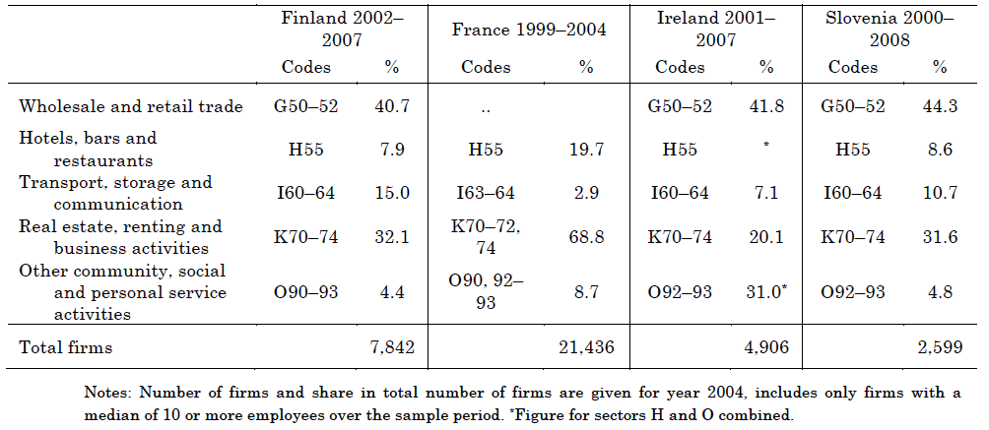
Data
Source: Eurostat; own calculations.

Slide 5
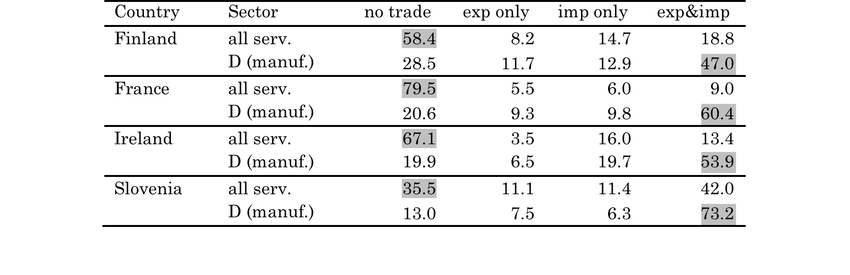
Trade participation (%)
Services firms are less engaged in trade than manuf. firms
Manuf.: 72 to 87%
Serv.: only 20 to 65%
Imports more likely than exports (serv.)

Slide 6
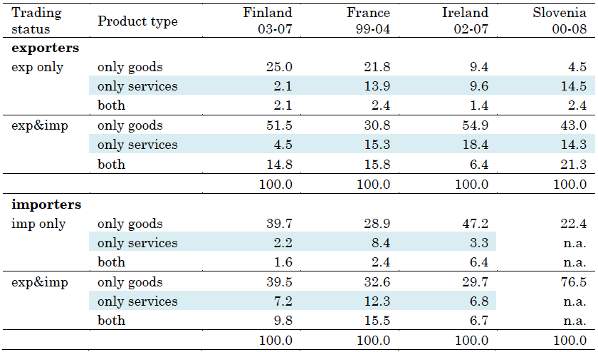
Trade participation (%) goods vs. services
  Services firms mostly engaged in trade in goods (48-77%)
Serv. only: Exp: 2 - 15%; Imp.: 2 - 8%
Both: Exp: 1 - 2%; Imp.: 7 - 15%

Slide 7
Trade premia

Slide 8

Trade premia
Y - performance indic. (empl., wages, LP and TFP)
Status – exp. only, imp. only, both
– goods, services, both
Control – emp, emp², wage (all logs), FDI, sector-time
Services firms
OLS – conditional diffs in perf.
FE – corr. between a change in trading status and a change in perf.

Slide 9
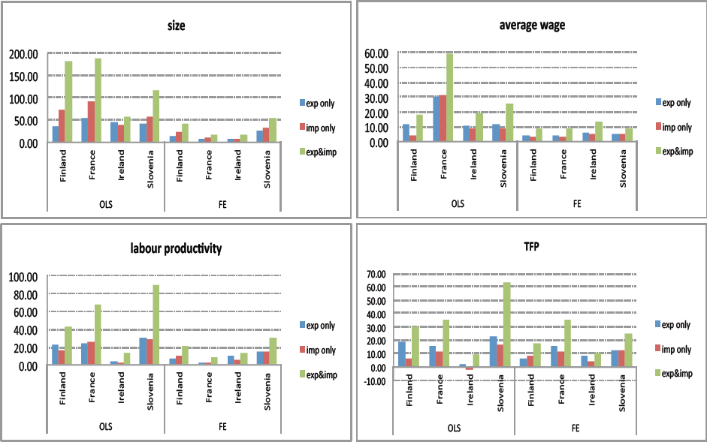
Trade premia – exp or imp
Largest premia for exp&imp, followed by exp.only
FE: firms benefit from changing trade status (to both)

Slide 10
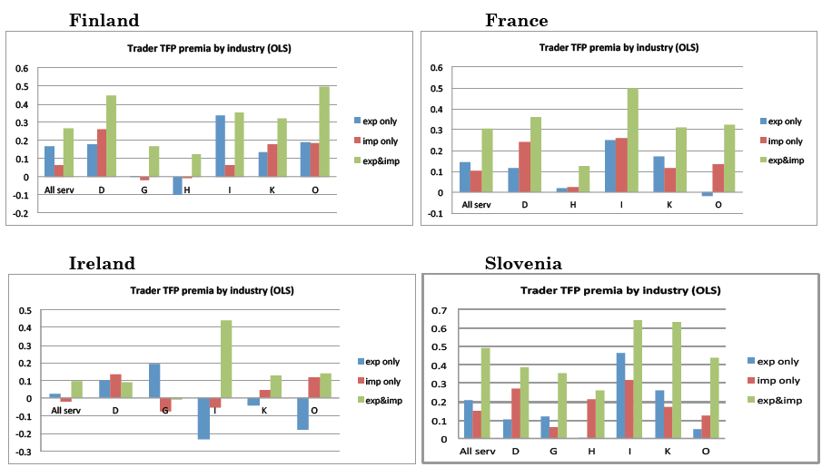
Trade premia (TFP) – by industry
Smaller premia for services than for manufacturing (FI, FR)
Highest premia for I, followed by K and O

Slide 11
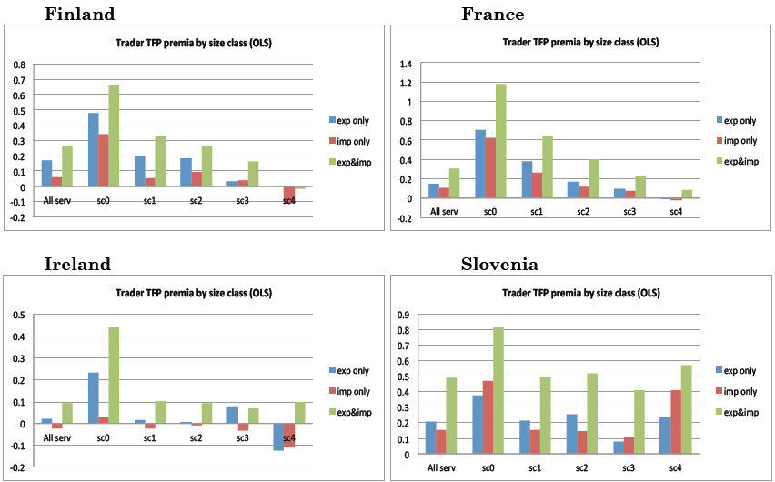
Trade premia (TFP) – by size classes
Largest premia for micro firms, decreasing by SC

Slide 12
Goods vs. services

Slide 13
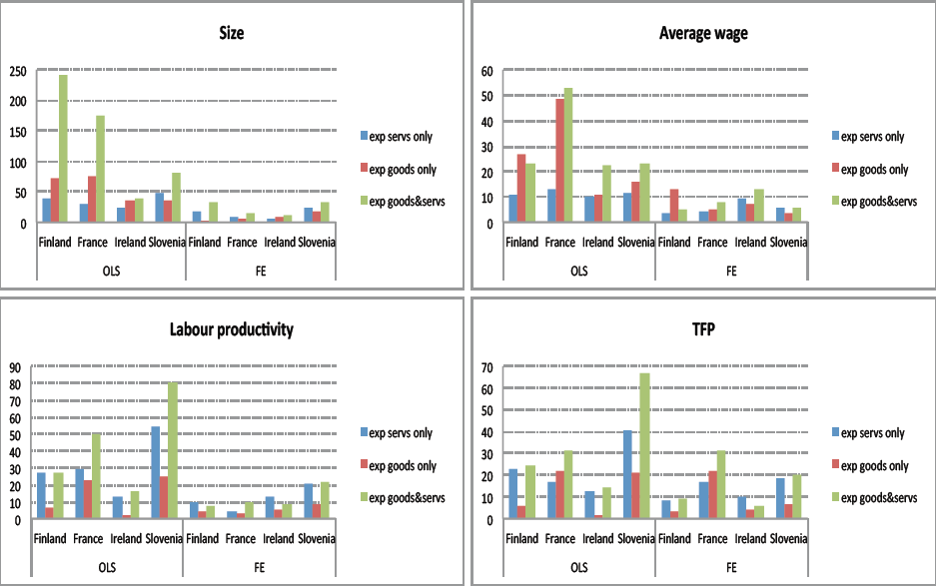
Exporter premia – goods vs. serv.
Largest premia for goods&serv., followed by serv.only (LP & TFP)

Slide 14
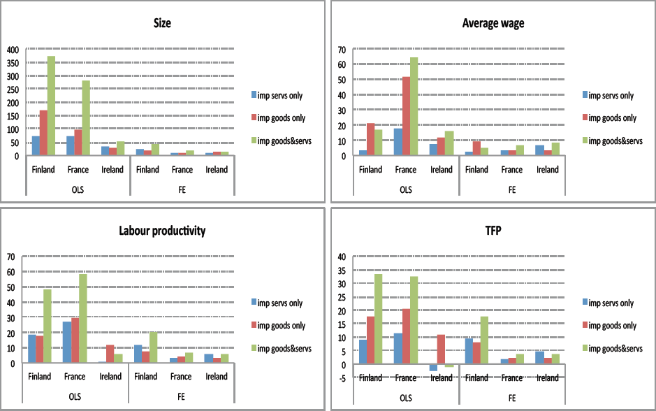
Importer premia – goods vs. serv.
Largest premia for goods&serv., followed by goods.only (LP & TFP)

Slide 15
Summary
Services firms are
  less engaged in trade than manuf. firms
  more likely to import than export
  most engaged in trade in goods
More complex traders (exp & imp)
  are bigger and more productive
Exporting services requires higher productivity (than for G)
  i.e. higher fixed cost
Importing services requires lower productivity (than for G)
  i.e. lower fixed cost

Slide 16
Switching premia

Slide 17
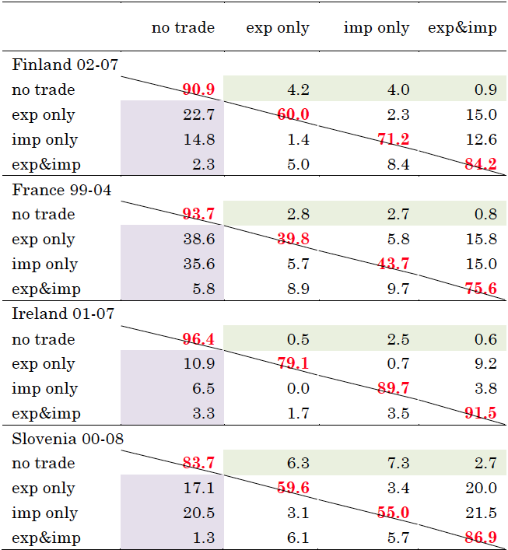
Transition matrices – trade statuses
High trade persistence; few starters (4-16%), but more stoppers (<40%)

Slide 18

Switching premia
Comparing pre-switch (t-2, t-1) and post-switch (t+1, t+2) peformance
Y - performance indic. (empl., wages, LP and TFP)
Switch – from no trade to X, M, X&M, and from one-way to two-way trade
Control – emp, wage (all logs), FDI, sector-time
OLS – avg. diff. between a cohort of today’s switchers and the reference group before (after) the switch

Slide 19
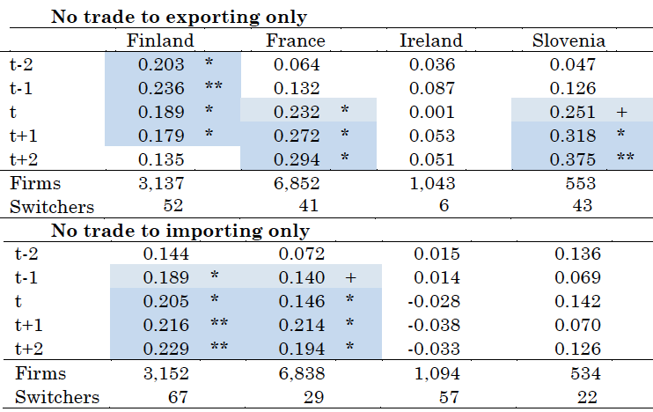
Switching premia (LP)
X-only: FR & SI M-only: FI & FR

Slide 20
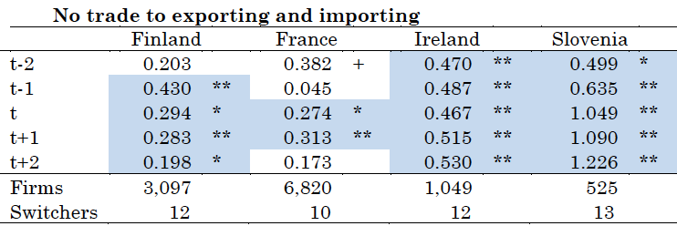
Switching premia (LP)
IRL & SI - increasing
FI – positive, but dissipating

Slide 21
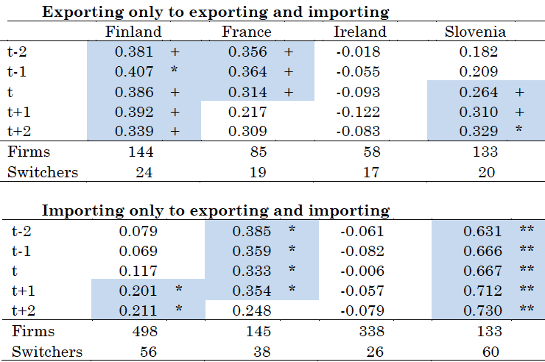
Switching premia (LP)
X to X&M: SI, decreas. in FI & FR M to X&M: FI & SI

Slide 22
Summary
SI: sig.premia in 4/5 episodes
  in 2 occurred after switch, in 2 strengthened after
FR: sig.premia in 2/5 episodes after switch
  in 2 decreasing or dissapperaring after switch
FI: sig.premia in 4/5 episodes before switch
  In 3 reduced after switch
IRL: sig.premia in only 1/5 episode increasing after switch
Hence, self-selection; learning very rare (SI)

Slide 23
Switching premia: goods ⬅➔serv.
Far less observations on switchers
Transition matrices suggest:
  switching from trade in services to trade in goods is easier than vice versa (higher FC in serv. trade)
Results:
  Similar results for exp and imp
  Sig. premia of switching only for switching from no trade to either trade in G or trade in S or trade in G&S
  But no premia for switching between G and S trade

Slide 24
Summary
Services firms are
  less engaged in trade than manuf. firms
  more likely to import than export
  most engaged in trade in goods
Complexity of trade activities is increasing in firm size and productivity
Changes in trading status by adding another dimension of trade
  are infrequent and associated with significant pre-switching premia
Learning effects from switching trading status are uncommon

Slide 25
Policy implications
Traditionally, trade policy aimed at boosting exports (manuf.)
Here, among serv. firms, prevalence of importers
  hence, assisting firms in finding suppliers abroad?
However, a lot of short-lived entry and exit from import and export markets
  Which is not a sign of a market failure
Higher barriers to trading services than goods:
  hence harmonizing international regulation and reducing entry barriers would do the job

